Slide 1

Automation Systems Overview
Welcome to PHOENIX CONTACT
PLCnext / Edge Controls / HMIs
Created by Peter Mannon
Automation Sales Engineer Phoenix Contact
Delivered today by Mark Dean PSE
With Dave Eifert, Senior BDM, IIoT

Slide 2

Limited Lifetime warranty
Sign up. http://www.PhoenixContact.com/LLW.
Use Phoenix Contact Surge Suppression and Power Supply (where required).
Limited Lifetime Warranty on all Phoenix Contact Parts in the Cabinet.
  There are a few exceptions, PCs, HMI, Mechanical relays. See web for details.
Notes:
SD-166530-B

Slide 3
Phoenix Contact – Automation Why ?
I have heard of the PLCnext,
What is it ?
Is it Different ?
What Makes it Different ?
Is it just another ‘ME TOO’ PLC ?
Notes:
3

Slide 4
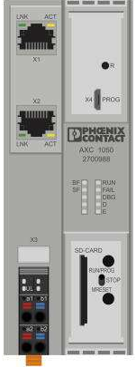
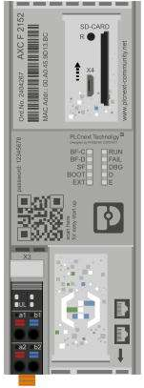
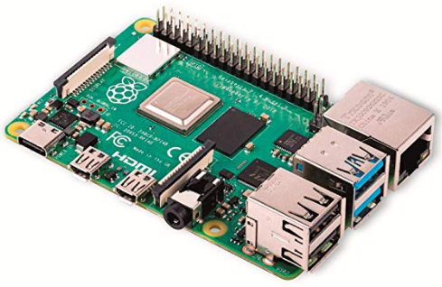
What is so Revolutionary ?
PLCnext Technology
+
=
PLC
Linux PC
PLCNext

Slide 5
What is so Revolutionary ?
PLCnext Technology
Advantages for PLC Users:
No Cost Software (Licensing)
Deterministic PLC Performance
Ability to Synchronize C++/C#/Python with Ladder !!
HTML 5 (Incredible Graphics)
Open Coms (OPC-UA)
Web Connectivity
Designed from Ground Up
as a IIOT Device
Advantages for LINUX Users:
Familiar Programming
Can Use Open Source Code
Program in C++/C#/Python/etc..
Support of Docker/Balena
REST Implemented
Familiar Linux Interface
Industrial Grade PLC
Industrial Grade I/O
No Software Licensing Fees.
No Restrictions.
Our Open Systems allow you to use Open Markets to get for free or for a fee – You Decide !!!
PLCNext

Slide 6
Control – PLCnext approach
PLCnext Technology
Open
IIot Ready
Reimagined

Slide 7
Control – PLCnext approach
PLCnext Technology
Open
IIot Ready
Reimagined

Slide 8
Control – PLCnext approach
PLCnext Technology
Open
IIot Ready
Reimagined

Slide 9
Control – PLCnext approach
PLCnext Technology
Open
IIot Ready
Reimagined

Slide 10
5 Things Your PLC Can’t Do
PLCnext Technology
5 Things Your PLC Can’t Do - But Should

Slide 11
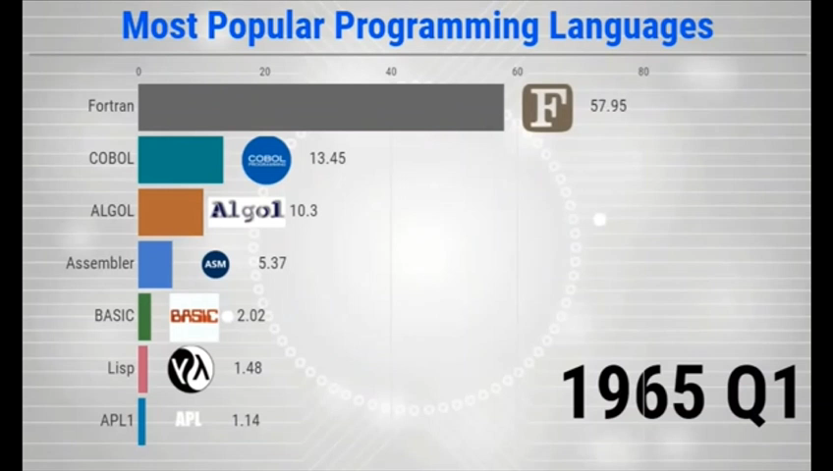
5 Things Your PLC Can’t Do - But Should
PLCnext Technology
1. Understand High-level Scripted Languages
HLL Languages – CAN your System Evolve with them ??

Slide 12









5 Things Your PLC Can’t Do - But Should
PLCnext Technology
1. Understand High-level Scripted Languages
2. Establish a Cloud Connection
PROFICLOUD
Advanced Analytics,
Data Storage,
etc…
PLC

Slide 13


5 Things Your PLC Can’t Do - But Should
PLCnext Technology
1. Understand High-level Scripted Languages
2. Establish a Cloud Connection
3. Interface with Databases
SQL
PLC

Slide 14

5 Things Your PLC Can’t Do - But Should
PLCnext Technology
1. Understand High-level Scripted Languages
2. Establish a Cloud Connection
3. Interface with Databases
4. Leverage Open Source Support

Slide 15
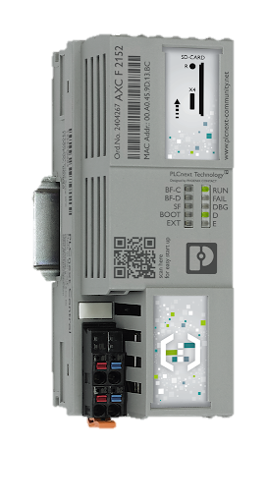

5 Things Your PLC Can’t Do - But Should
PLCnext Technology
1. Understand High-level Scripted Languages
2. Establish a Cloud Connection
3. Interface with Databases
4. Leverage Open Source Support
5. Easily Incorporate New Technology
Means Independence for Industrial Users.
No longer Waiting for Control Manufacturers to develop ‘Hooks’ or a new Dedicated System ……

Slide 16


















PLCnext: Swiss Army of Control
PLCnext Technology
Notes:
Reason: These are the many tools of PLCnext… like the knife, you can use these tools to solve many applicaions
Ted: Like a swiss army knife the PLCnext control has many tools… and these tools can be used solve different applicaions. They all don’t have to be used together… but, one, two, or more can be used to do more then ever before.
Lets look at some examples:
Followign slides
ACTION: highlight the different technologies here and relate them to a few applications on the following slides.

Slide 17

Complete Ecosystem – From Control to Cloud Integration
PLCnext Technology

Slide 18
Complete Ecosystem – From Control to Cloud Integration
PLCnext Technology

Slide 19

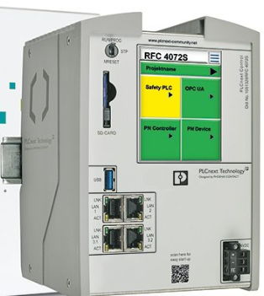
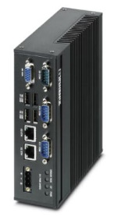
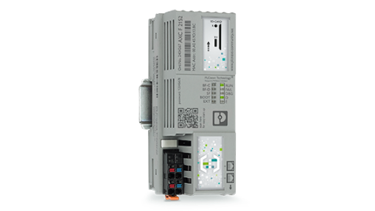
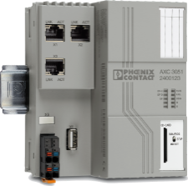


PLCnext Controls Roadmap
PLCnext Controls
Function
PLCnext Technology for IPC
RFC 4072 (S)
NEW !
AXC F 3152
AXC F 2152
AXC F 1152
Performance
Notes:
19

Slide 20
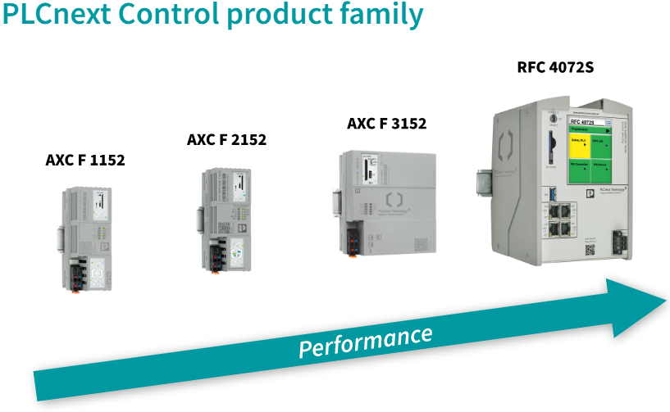


Common Functions / Features for entire Family
PLCNext Controls
Linux RT – Kernel (Debian / Yocto)
SD Flash card slot
Firewall / VPN (VPN OPEN / IPSEC)
OPC-UA Server Integrated
Integrated HTML 5 For Visualization
ProfiNet / Modbus / Ethernet I/P (Slave-Adapter)
ProfiCloud Gateway
IEC61131-3, C++, C#, Simulink
MRP / PROFINET® Rendundancy
NTP Timer Server Configuration
Logic Analyzer / Breakpoints / Advanced Debugging
1x 2x 5.4x 29x

Slide 21
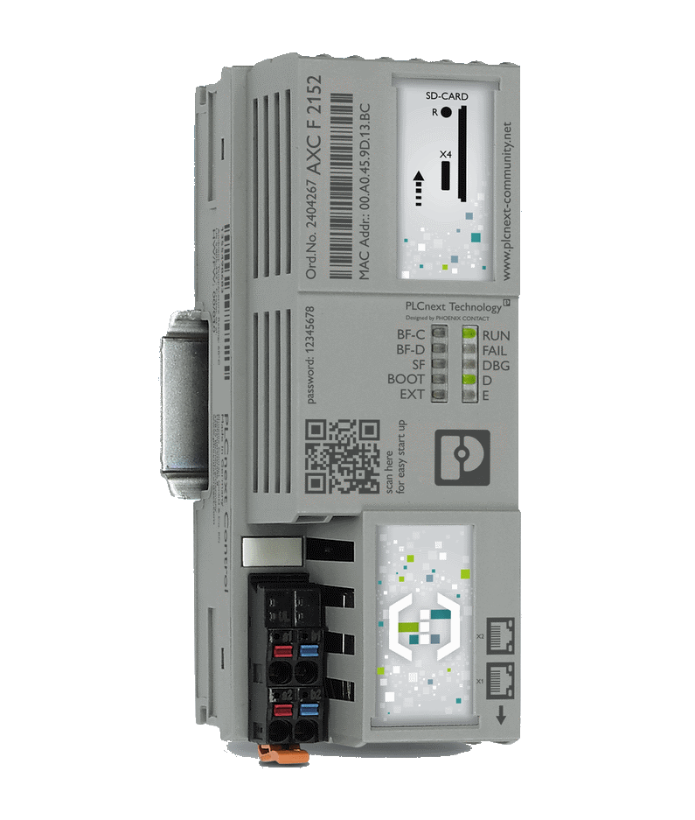
PLCnext Control AXC F 1152
PLCNext Controls
ARM® Cortex® -A9 (32bit) - 800 MHz Single Core
512 MB RAM / 512 MB Flash - 48k NVRAM
2 x Ethernet (10/100 Mbit) switched
8 Tasks – 5ms Fastest ScanTime
ProfiNet: 4 Devices@2ms – 16 Devices@4ms
Temperature range: -25°C to +60°C

Slide 22
PLCnext Control AXC F 2152
PLCNext Controls
ARM® Cortex® -A9 (32bit) - 800 MHz Dual Core
512 MB RAM / 512 MB Flash - 48k NVRAM
2 x Ethernet (10/100 Mbit) switched
Optional 1 x Added NIC Card (10/100/1000 Mbit)
16 Tasks per Core (32 Total)– 1ms Fastest ScanTime
ProfiNet: 4 Devices@2ms – 64 Devices@16ms
C1/D2 and Maritime Approvals
Temperature range: -25°C to +60°C

Slide 23
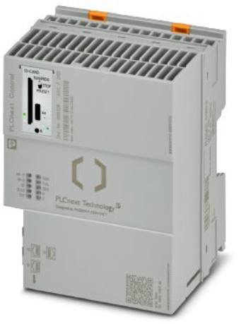
PLCnext Control AXC F 3152
PLCNext Controls
Intel® Atom™ X5-E3930 - 1.3 GHz Dual Core
2048 MB RAM / 512 MB Flash – 1MB NVRAM
3 x NICs Ethernet (10/100/1000 Mbit) switched
16 Tasks per Core (32 Total)– 0.5ms Fastest ScanTime
ProfiNet: 32 Devices@1ms – 128 Devices@4ms
C1/D2
Temperature range: -25°C to +60°C

Slide 24
PLCnext Control RFC 4072S
PLCNext Controls
Intel® i5 6300U 64bit - 2.4 GHz Dual Core
2048MB RAM / 8GB Flash – 2MB NVRAM
Dual Processors (A8/A6) – Functional Safety Rated.
16 Tasks per Core (32 Total) – 0.5ms Fastest ScanTime
Touch display
ProfiNet: 64 Devices@1ms – 256 Devices@8ms
3 NICs Ethernet
  NIC1/NIC2 = 2 x 10/100/1000 Mbit
  NIC3 = 2 x 10/100 Mbit switched
USB A
Temperature range: 0°C to +60°C
RFC 4072S: Integrated Safety PLC

Slide 25
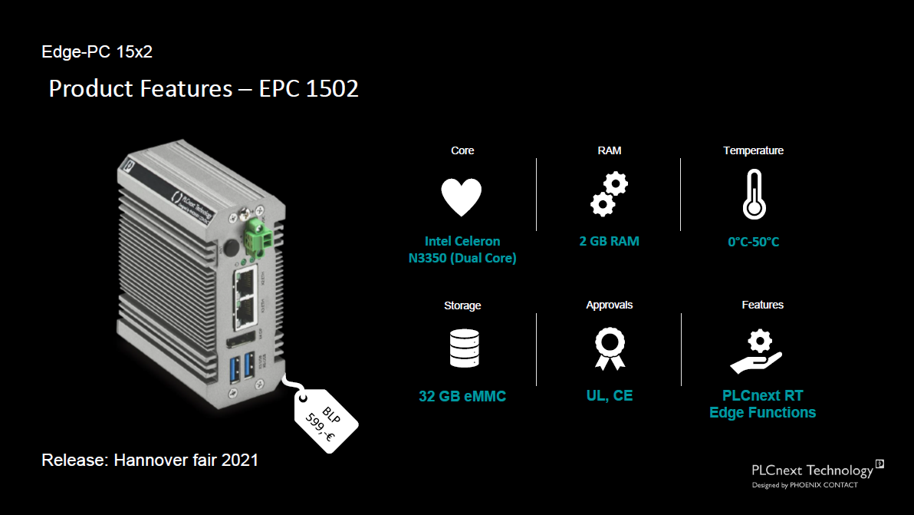
PLCNext Controls
$750

Slide 26
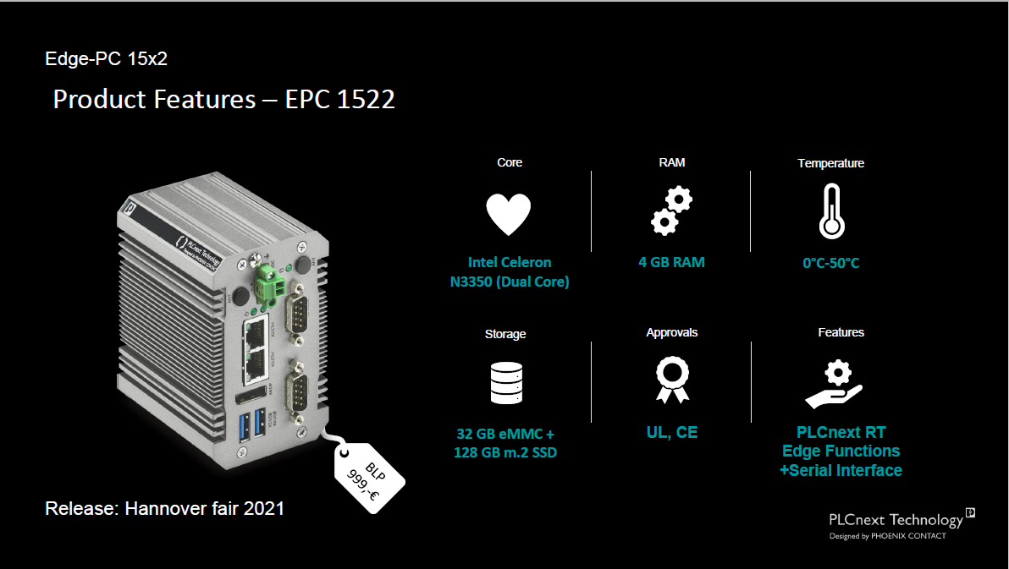
PLCNext Controls
$1200

Slide 27
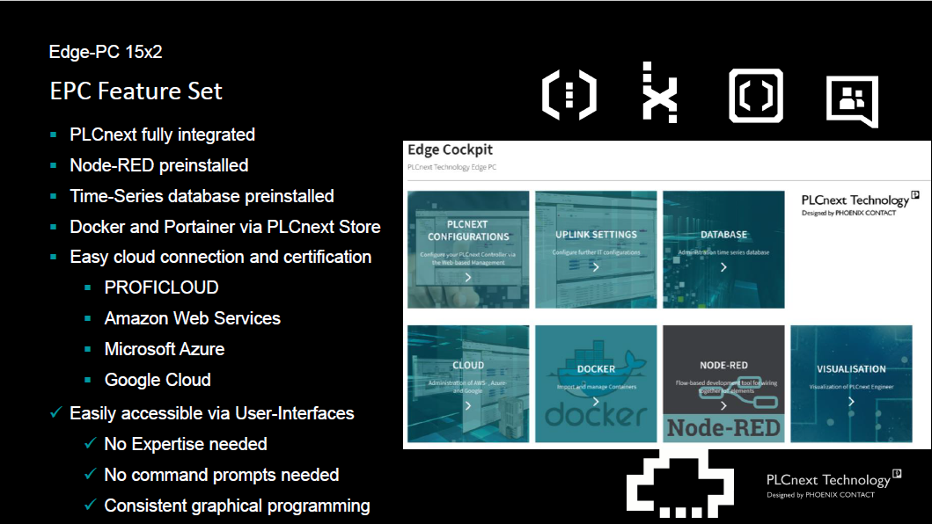
PLCNext Controls

Slide 28
PLCnext I/O Solutions
PLCNext Controls

Slide 29
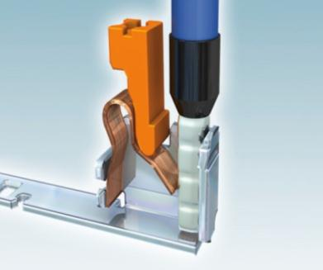
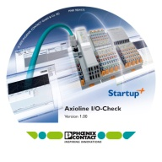
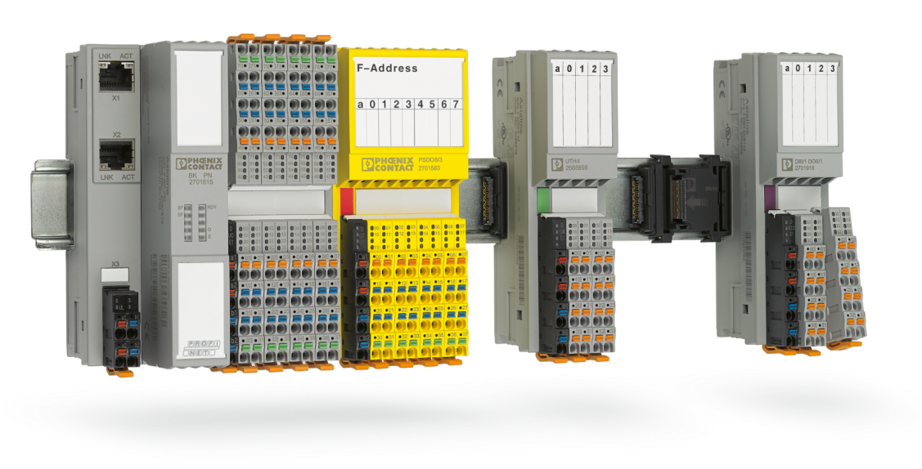


AxioLine I/O - Advantage – fast, robust, easy
PLCNext
Easy
Fast
Robust
Easy start-up by means of rotary encoding switches and Startup+
Decrease installation time with Push-in technology
Backplane design and location reduced radiation
Easy
Individual and fast labeling thanks to the MARKING system
Robust
EMC protection with adjustable filter times
Fast
Fast
Easy
Robust
Fast module exchange with pluggable I/O connections
Increase in the system output due to fast and signal acquisition
Wiring with Colored Terminals
Wide Temperature options with XC variants -40°C … 70°C

Slide 30
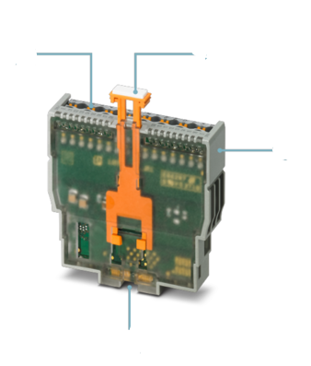
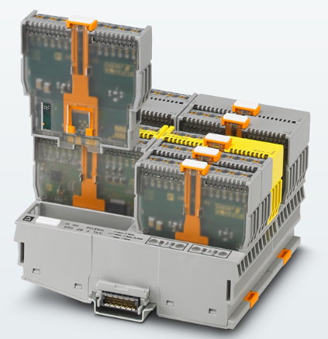
Smart Elements – Modular I/O
PLCNext
Push In Connection
Tool Free
Upto 16 AWG Wire
Built-In Locking Mechanism
Quick and Easy Install and Removal
Compact
15mm x 62mm
Modular
Scalable
Compact
Cost-Effective
Common Carrier
Enables Large Variety in same
form factor

Slide 31
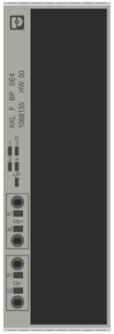
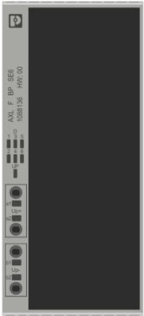
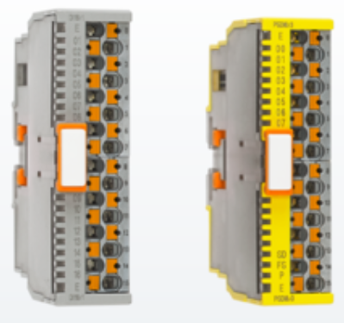
Smart Element I/O - Advantage – Flexible, Compact, Inexpensive
PLCNext
1. Choose Module Carrier
BP SE4 – 4 Slots
ONLY 40mm wide !
BP SE6 – 6 Slots
ONLY 55mm wide !
2. Choose Modules
14 Different Functions
No Module Settings
No Dials
No Jumpers
Freely Mix/Match Modules within a Carrier
Digital
AXL SE DI16/1
AXL SE DO16/1
Analog
AXL SE AI4 I 4-20
AXL SE AI4 U 0-10
AXL SE AO4 I 4-20
AXL SE AO4 U 0-10
Temperature
AXL SE RTD4 PT100
Special Function
AXL SE RS 485
AXL SE INC1 SYM
AXL SE CNT1
AXL SE IOL4
3. Insert Modules into Carrier
Upto 96 Digital or 24 Analog Signals in 55 mm Wide !!!

Slide 32
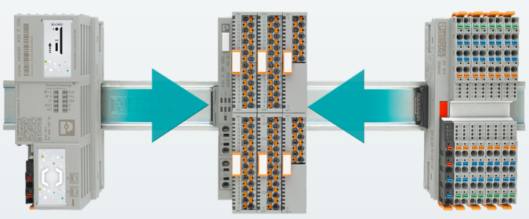
PLCnext Smart Elements AxioLine I/O
PLCNext
You can Freely Integrate anywhere with Standard AxioLine Modules !!!!

Slide 33
Complete Ecosystem – From Control to Cloud Integration
PLCnext Technology

Slide 34
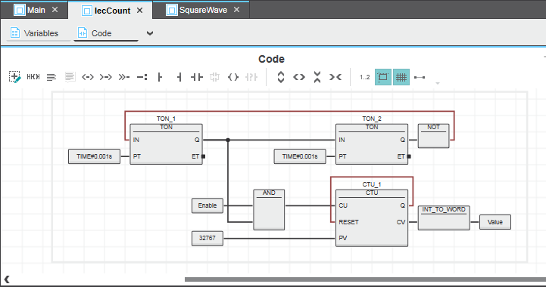
PLCnext Engineering
PLCNext
Standard IEC61131:
ST
FBD
LADDER
SFC
SAFETY PLC
Integration with:
C#, C++, Python
MatLab Simulink
Synchronous Execution of High Level Languages

Slide 35
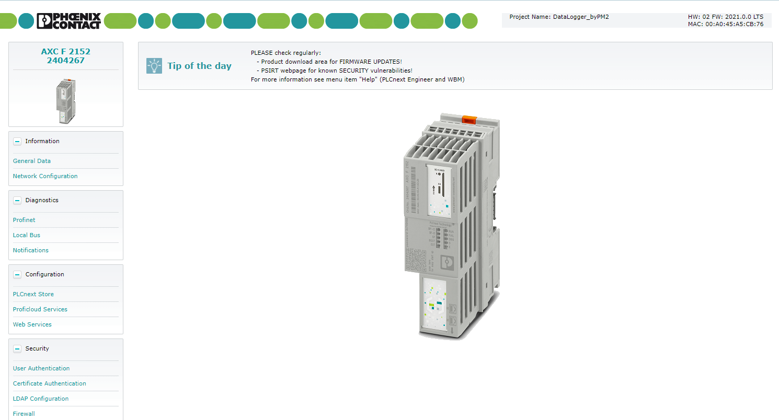
Web Based Management
PLCNext
Advanced Access:
Passwords
Firewall / VPN
I/O Diagnostics
Web Services
Firmware Updates, etc..

Slide 36
Complete Ecosystem – From Control to Cloud Integration
PLCnext Technology

Slide 37
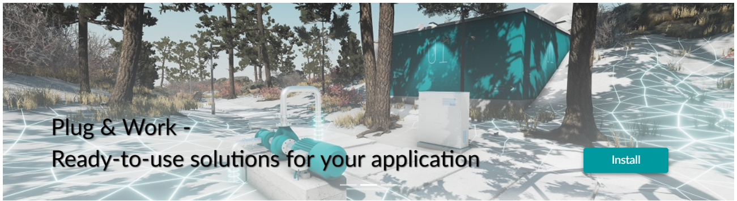










Code Repository, Apps, Free and For Fee
PLCNext Store

Slide 38
Complete Ecosystem – From Control to Cloud Integration
PLCnext Technology

Slide 39
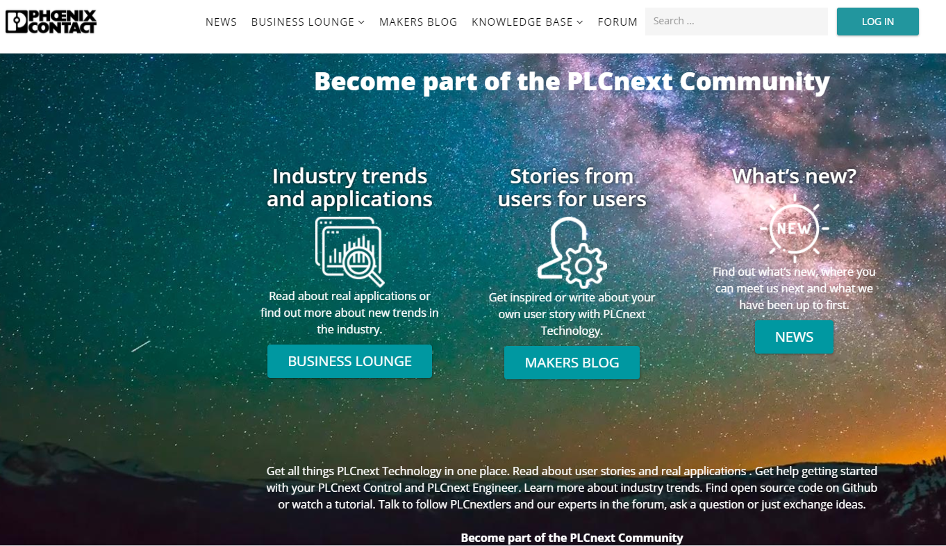
PLCnext Community
PLCNext

Slide 40
Landing Page
PLCNext
http://www.phoenixcontact.com/OPEN
  PLCNext Community (Developer, other customers)
    Developers and Other Customers
    How-Tos.
    Vidoes
    Etc…
  Direct Links
    Hardware Spec
    Software Specs and Downloads
    PLCNext Store (Free and for Fee) Functions/Function Blocks.
    Github Links..
    ……. Much More…

Slide 41

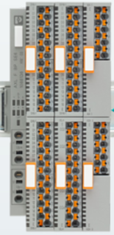
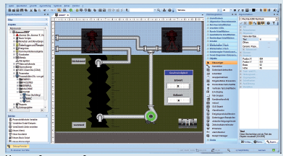
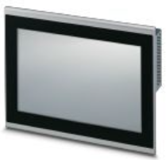
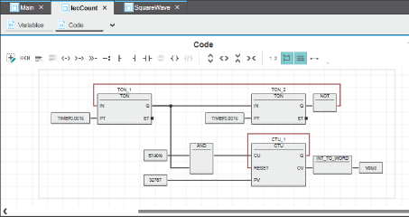
Phoenix Contact – Automation Visual Display Options
PLCnext
  Ethernet/Serial Coms
  Communications ProfiNet, Modbus,
  Ethernet I/P (Slave Only)
Applications:
  Medium to Large machines
  Web-Connected Machines
  HLL Needed/Wanted
Programming Software:
  PLCnext Engineer (Free) –
  SFC / MatLab Add Ons
Visualization:
  Pair with Traditional HMI with
  External Software
  *Visu+ Express (free)
  * Visu+ (Paid License) ILC
  OR
  - Use HTML5 Thin Client
OR
HTML5 Web Panels

Slide 42
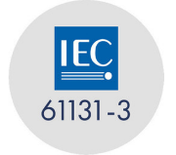




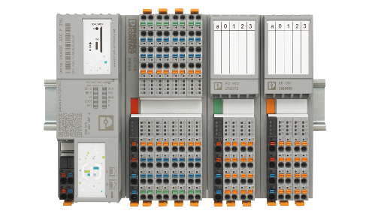
Phoenix Contact – Automation Use Cases
Use Cases ?
~60% Use Only PLC
~10% Use Only Linux
~30% Use PLC/Linux
The PLC/Linux Space
Is Quickly growing and will most likely be our Largest Segment in 2-3 Years.
Linux Operating System
Axioline Industrial I/O Hardware

Slide 43




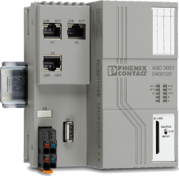

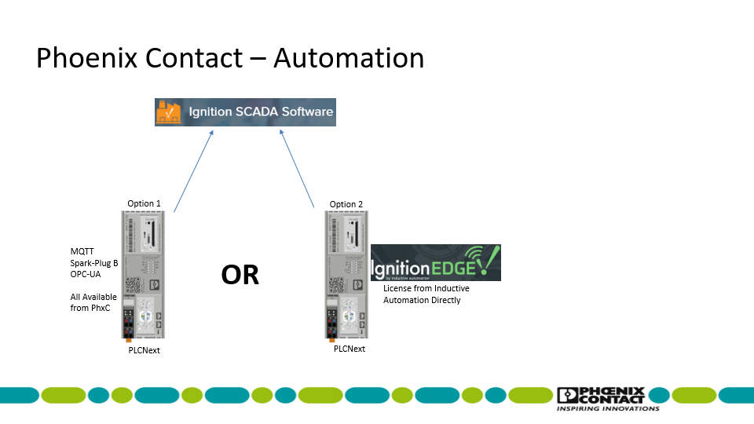
Phoenix Contact – Automation – Integration- Ignition/SCADA/Other
OPC-UA
MQTT
*Spark Plug B
OR
Whether the Scada is Local or ‘In the Cloud’, We can get you there !!!
*Spark Plug B to be released Q1 2022

Slide 44

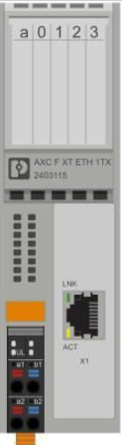



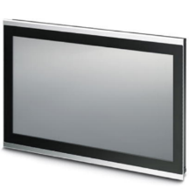
Phoenix Contact – Automation – Network Interfaces
Add Wifi for Mobile Device Control/View
Connect to Wireless
Network
Connect to HTML Screens
Wifi Access
Point
PLC with I/O
- NO SOFTWARE FEES
HTML 5 Screens Served inside
DI/DO - AI/AO
RS-485 Coms (ie. Modbus)
1
2
Thin Client to
View / Control
HTML 5 Screens
System Network Connection if Desired
Open Camera on Device.
Scan Barcodes
View Same HTML 5 Screens
C1D2 Available
Notes:
Difference between the BTP2000/TP3000 HMI and the BWP2000/WP4000 HTML5 web panel.

Slide 45

Phoenix Contact – Automation – Network Interfaces
Add Wifi for Mobile Device Control/View
Connect to Wireless
Network
Connect to HTML Screens
MQTT to Cloud
With Internet Connection, MQTT to any
Cloud Service (AWS/Google Cloud,
Azure, etc..)
Wifi Access
Point
PLC with I/O
- NO SOFTWARE FEES
HTML 5 Screens Served inside
DI/DO - AI/AO
RS-485 Coms (ie. Modbus)
1
2
Thin Client to
View / Control
HTML 5 Screens
System Network Connection if Desired
Open Camera on Device.
Scan Barcodes
View Same HTML 5 Screens
C1D2 Available
Notes:
Difference between the BTP2000/TP3000 HMI and the BWP2000/WP4000 HTML5 web panel.

Slide 46

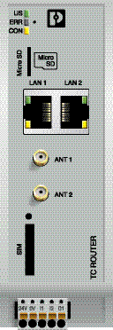
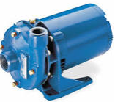
Phoenix Contact – Automation – Network Interfaces
Router for Text Messaging
4G Router
PLC Input Goes High
– Motor Fault
Pump Motor Faulted !!!
RESET Pump Fault
Pump Motor Running
PLC Clears Fault
Engages Motor to Restart
Motor Fault occurs
Motor Running
Motor Running
Notes:
Difference between the BTP2000/TP3000 HMI and the BWP2000/WP4000 HTML5 web panel.

Slide 47
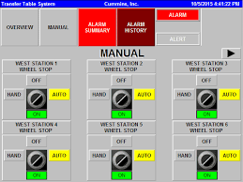
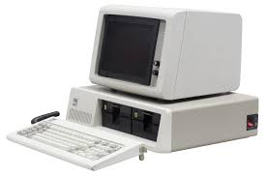
Phoenix Contact – Automation – Network Interfaces
Remote Connectivity
4G Router or
mGuard
PLC with I/O
- NO SOFTWARE FEES
HTML 5 Screens Served inside
DI/DO - AI/AO
RS-485 Coms (ie. Modbus)
Local
Thin Client to
View / Control
HTML 5 Screens
View / Control
Same Screens –
Locally AND Remotely
Notes:
Difference between the BTP2000/TP3000 HMI and the BWP2000/WP4000 HTML5 web panel.

Slide 48
THANK YOU !!
PLCNext

Slide 49
PLCNext
Port 1
PLC:
IP ADD: 192.168. 1. 10
SubNet: 255.255.255.0
GW: 192.168. 1. 1
FLOWSERVE NETWORK:
ROUTE: 172.18.10.2
Port 2
IP ADD: 178. 18. 8.20
SubNet: 255.255. 248. 0
GW: 172. 18. 10. 2
Cellular ROUTER
ROUTE: 192.168.1.1
255.255.255.0
Port 3
IP ADD: 192.168.3.10
SubNet: 255.255.255.0
GW: 0. 0. 0. 0
Hard Wire PC Ethernet
IP Add: 192.168.1.15
255.255.255.0
GW: 192.168.1.1
PLCnext

