Slide 1
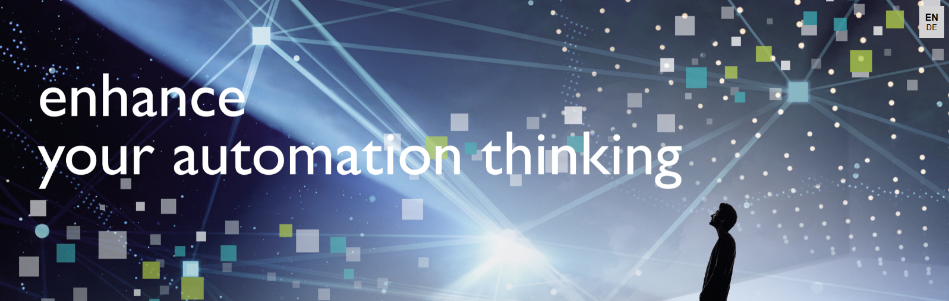
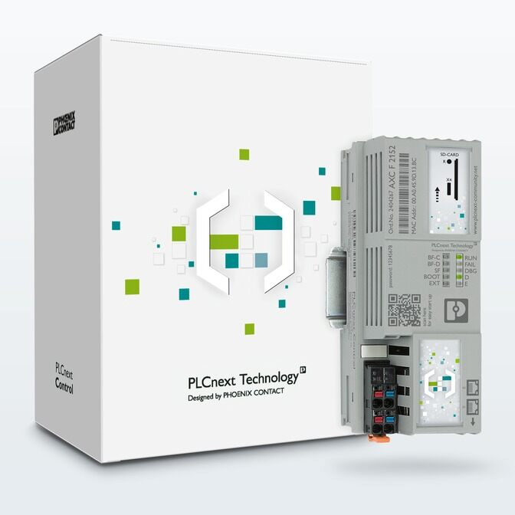
PLCnext Technology
Part 1 - Getting started and writing your first program
Acknowledgments: Thanks to Loren Brown and Yuri Chamarelli of Phoenix Contact, to Mark Mays of TC Energy, and to Rajvir Singh of Code and Compile for their help in revising this presentation.
Notes:
Upon delivery, the PLCnext Controller (e.g. AXC F 2152) is loaded with the IP address: 192.168.1.10.
Set your laptop’s Ethernet adaptor to the fixed IP address: 192.168.xxx. Xxx can be any number between 1 and 255, except for 10.
Accept the default subnet mask (255.255.255.0)
Make a connection between your laptop and one of Ethernet ports on the PLCnext controller using the browser on your laptop.
Type: 192.168.1.10 into the browser’s search field. You will likely get a warning that this “website” is not trusted. Depending on your browser, the warning will look something like this: Click on details, and click on “Go to the Website”, or “continue on to website anyway”

Slide 2
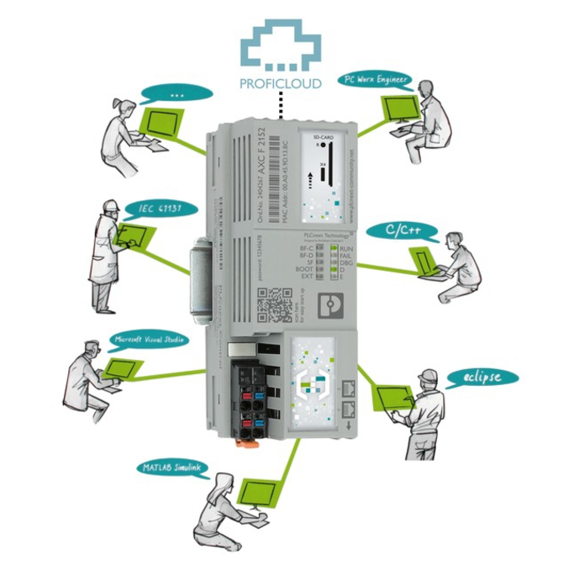
Topics
Introduction to PLCnext hardware – the PLCnext starter kit
Connecting and communicating with the PLCnext controller
  Accessing configuration interface for the PLCnext controller
    Setting up the laptop to communicate with the PLCnext controller
Initial configuration of the PLCnext controller
Introduction to PLCnext software – PLCnext Engineer
Acquiring and installing PLCnext Engineer software
…continued, next page

Slide 3
Topics, continued
Getting started with PLCnext Engineer software
  Opening a new project
  Aligning communications between project and the controller
  Adding input and output modules to the project
  Parameterization of the I/O
  Connecting to the controller, downloading and running the project
  Creating variables, linking them to I/O in the program
Programming preliminaries
  Importing a function block into the program
  Open a new program, and the code tab, drop in a function block
  …continued on next page

Slide 4
Topics, continued
Programming for real
  Parameterization of the AI_Norm function block
    Declaring variables
    Specializing the blocks to handle our real-world inputs
  Programming some digital I/O, working with a Greater Than function block
    Program two Greater Than function blocks
      Create new variables to “turn true” when the appropriate input reaches a threshold
      Link these new variables to real digital outputs on the PLCnext controller
  Download to the controller and run, verify proper operation
    While online with the controller, check the program for real-time values
…continued on next page

Slide 5
Topics, continued
Programming the HMI (Human-Machine Interface)
  Accessing the HMI development area
  Creating a page
  Dropping an object onto the page, and configuring the object
  Disabling the need to sign-in to view the HMI (safe for demo purposes)
  Viewing the live HMI application in a browser
  Detailed instructions in developing HMI pages, linking them to the program
    Using Text, Objects and Symbols
      Configuring settings, parameters, dynamics
End
Appendix
  Accessing the PLCnext Community
  Accessing more information on the PLCnext site on the internet

Slide 6
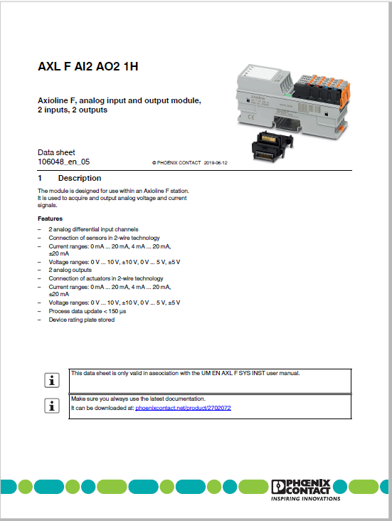
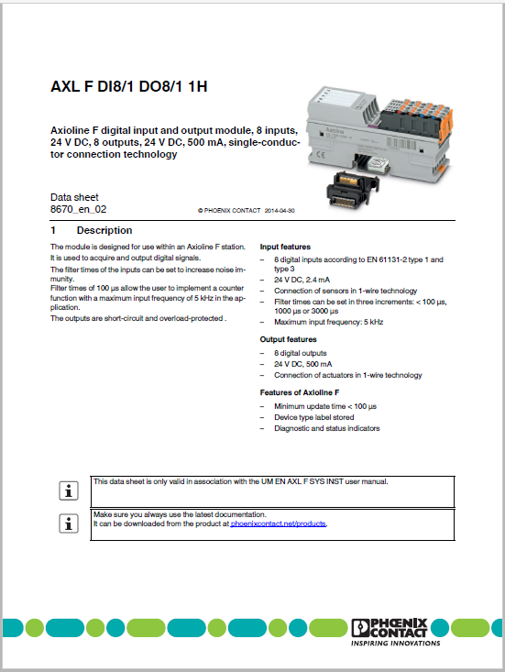
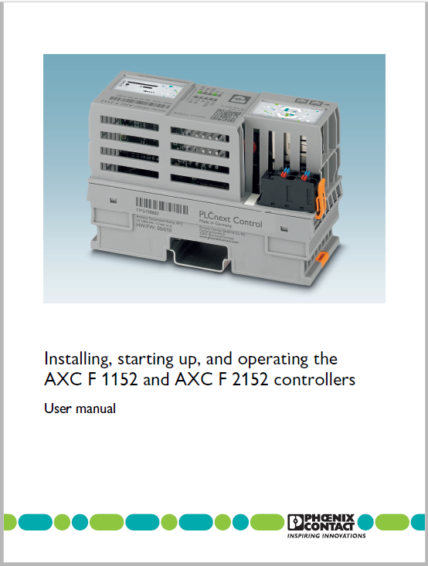
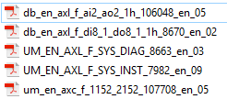
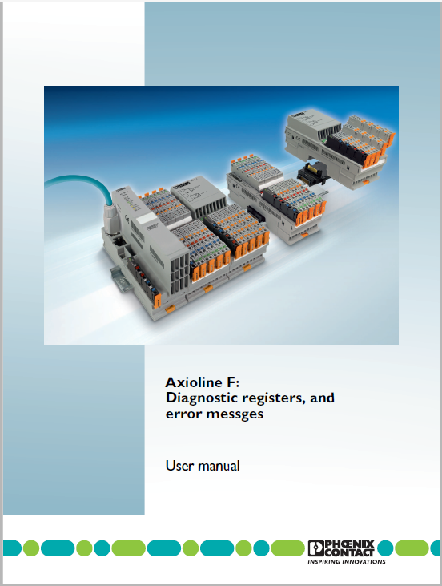
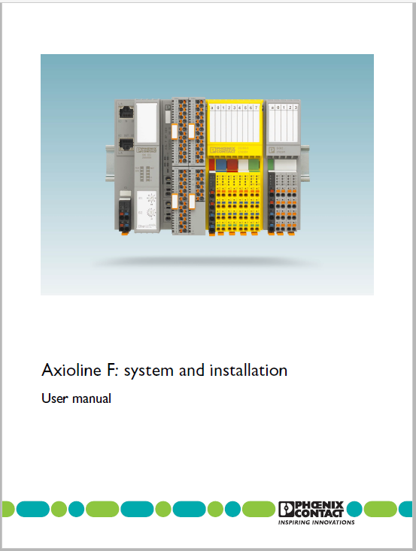
Useful resources - User manuals and data sheets
These can each be found under the “downloads” section for each of the components used in this system
They will help clarify wiring points, etc.
Also – CLICK HERE to check out Rajvir Singh’s Youtube channel for several PLCnext training videos

Slide 7

Hardware – PLCnext Starter Kit
AXC F 2152 STARTERKIT
Order # 1046568
…or build your own:
Controller - AXC F 2152 - 2404267
DI/DO Module – DI8 /1 DO8 /1 – 2701916
AI/AO Module – AI2 AO2 – 2702072
*I/O Exerciser - 5603026
*To follow the programming example in this training, a means for generating a 0-10vdc analog input signal and a 4-20mA analog input signal is needed.

Slide 8
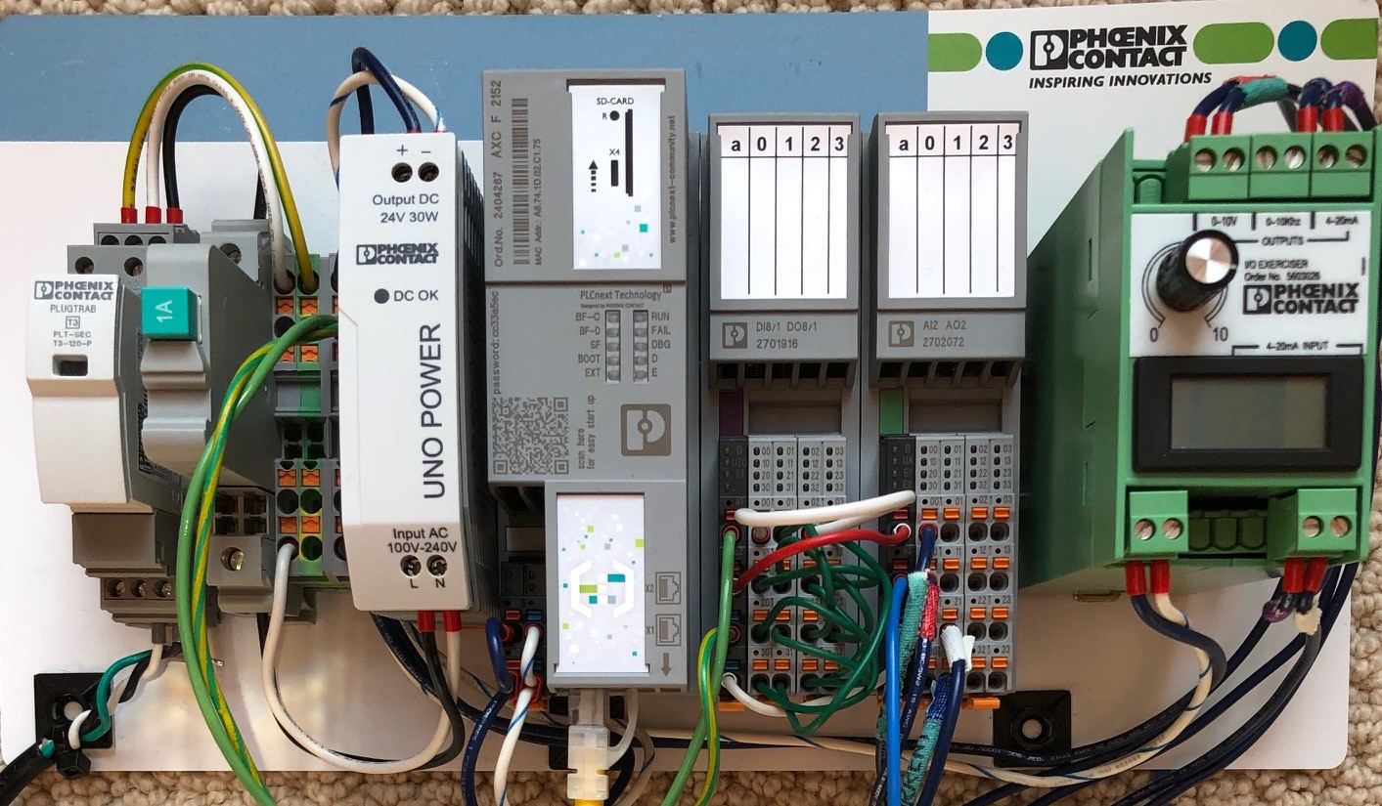
Hardware – Actual setup used for exercise
Controller - AXC F 2152
2404267
DI/DO Module – DI8 /1 DO8 /1
2701916
AI/AO Module – AI2 AO2
2702072
I/O Exerciser
5603026
This hardware is powered with 24vdc, thus a power supply to convert from 120vac to 24vdc is required, as shown. Also shown on the DIN rail: terminal blocks, circuit breaker and surge protective device.

Slide 9
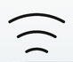

Connect to internet via WiFi, and to PLCnext controller via Ethernet cable

Slide 10
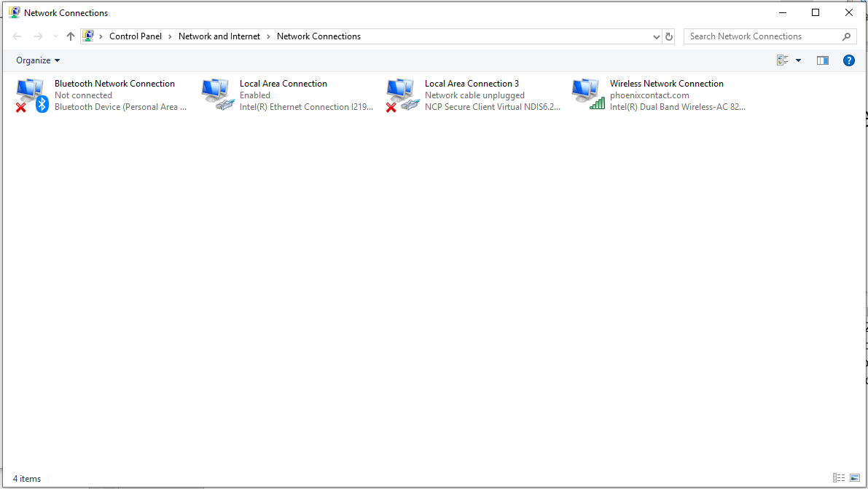
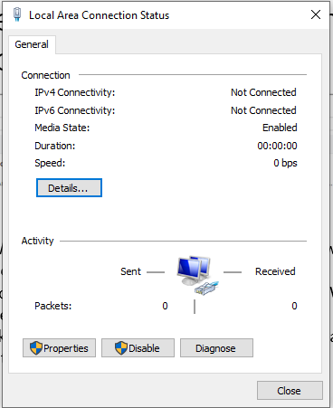
Configure your computer to communicate with the PLCnext controller
From your Windows computer’s start menu, go to “Network and Internet”, then to “Network Connections”
Assuming you can reach the internet via the computers Wireless Network connection, leave that setting as it is
Double-click on “Local Area Connection” to configure that connection to be able to communicate with the PLCnext controller

Slide 11
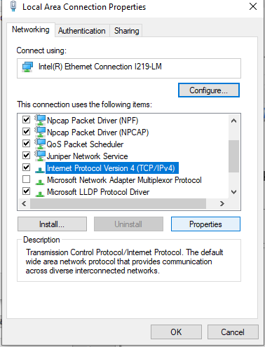
Communicating with the PLCnext controller
Setting a fixed IP address on your computer’s Ethernet adaptor
1
Click on Properties here…
2
…click this
3
..and then here

Slide 12
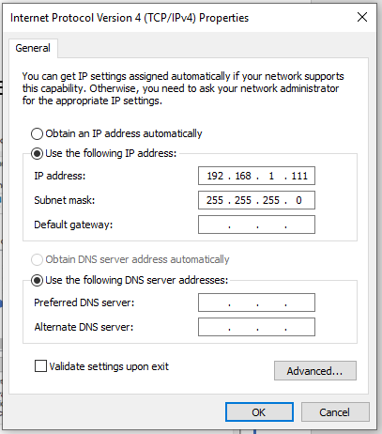
Communicating with the PLCnext controller
Setting a fixed IP address on your computer’s Ethernet adaptor
Click on “Use the following IP address:”
Type in 192.168.1.xxx
  The value for xxx can be anything between 1 – 254, except 10
    (192.168.1.10 is being used by the PLCnext controller)
The Subnet mask number should automatically fill in
  If not, type in the number shown
Click Okay
Your computer’s Ethernet adaptor is now configured with the above fixed IP address, and will be able to communicate with the PLCnext controller

Slide 13

Communicating with the PLCnext controller
The PLCnext controller ships with a default IP address: 192.168.1.10
We can communicate with the PLCnext controller by simply entering an IP address into a browser.
If we want to change the IP address, we must use PLCnext Engineer to do so.
We will download and install PLCnext now.

Slide 14
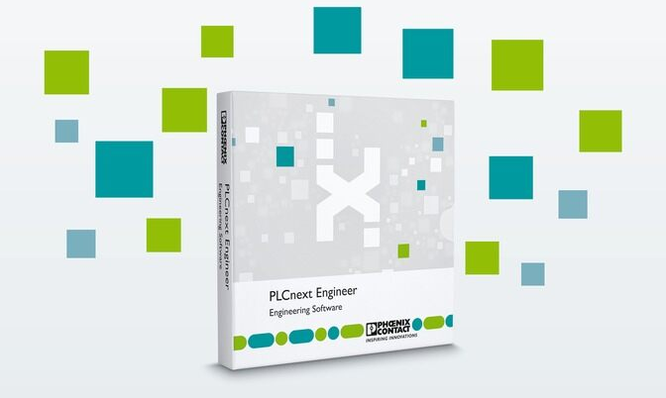
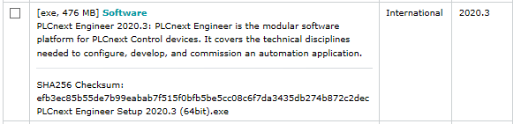

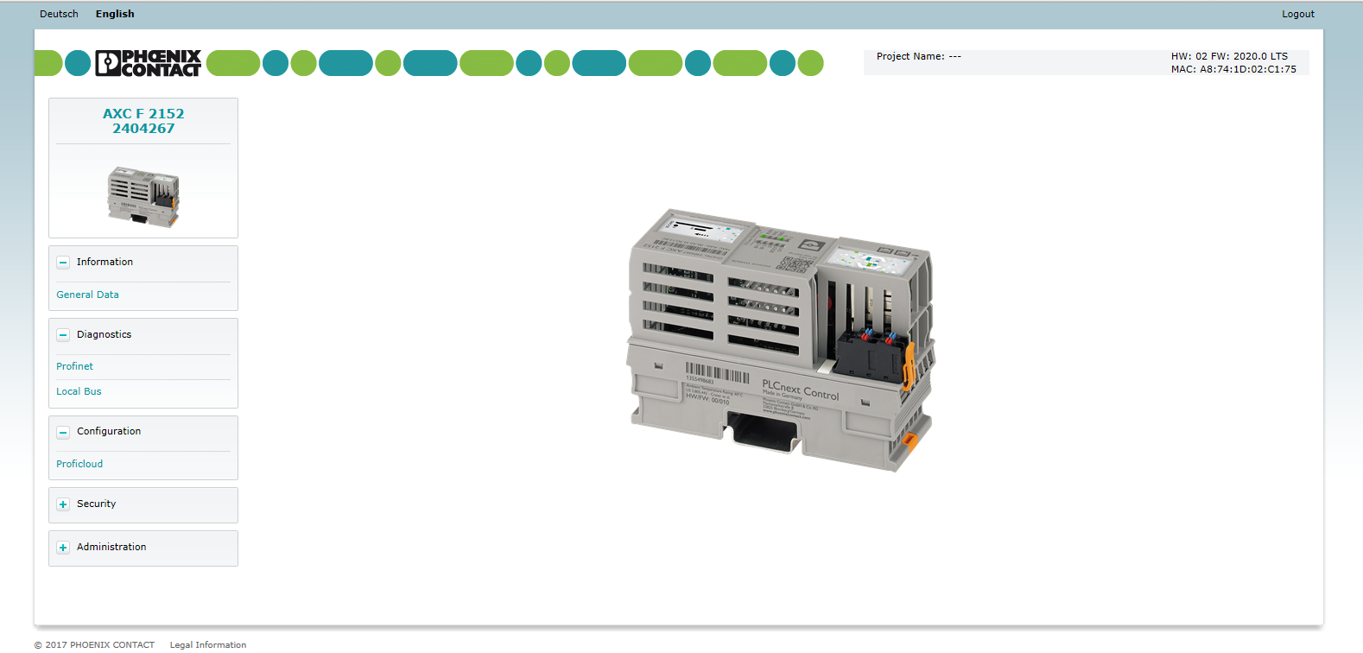
Software - PLCNEXT ENGINEER - 1046008
Don’t place an order for the software, just download it from the Phoenix Contact website! https://www.phoenixcontact.com/online/portal/us
IMPORTANT!! Notice the software version (2020.3) must match or be older than the firmware revision on the PLCnext controller. If the firmware revision on the PLCnext controller is older than the version of PLCnext Engineer, then the PLCnext controller’s firmware must be updated.
Information from the PLCnext controller’s web- based management:
Notes:
There is no cost, and no license files to install.
Just download the software and install it like any other software.

Slide 15
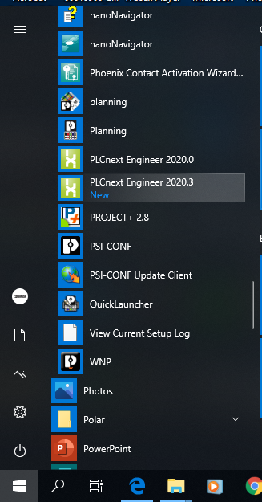
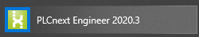
PLCnext Engineer – programming software
Once installed,* The PLCnext Engineer software will be visible under the Phoenix Contact folder after clicking on the Windows symbol at the bottom/left of the screen.
Notice the software version (2020.3). The PLCnext Engineer software must be of the same vintage, or older than the Firmware level on the controller.
* Once the software has been downloaded and unzipped, right-click and choose “install as Administrator” for best results.

Slide 16
Software and controller – ensuring compatibility
Now that the PLCnext Engineer programming software has been downloaded and installed, let’s take a look at the PLCnext controller’s web-based management to note the firmware version
If the firmware is older than the PLCnext Engineer software, then we will need to update the firmware
Enter your PLCnext controller’s IP address into the address field of your browser.
  (The default IP address is 192.168.1.10)
  Make sure your laptop is set up to talk to the PLCnext controller. See slides 10 and 11 if you need to change your laptop’s IP settings.

Slide 17
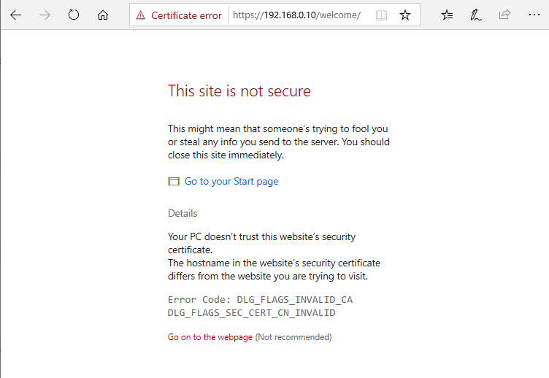
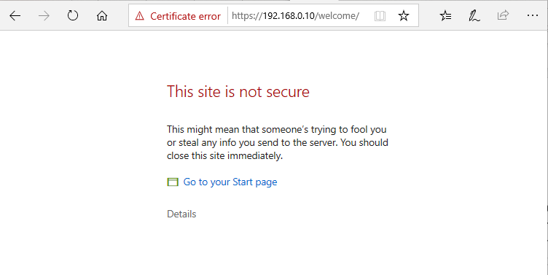
Access the PLCnext controller’s internal webpage
When you’ve entered the PLCnext controller’s IP address in the browser and hit enter, you will get an error like the one shown here (Microsoft Edge browser).
In this case, click “Details”, and then ignore the warnings about the site potentially being unsafe, and proceed to the PLCnext controller’s web interface.

Slide 18
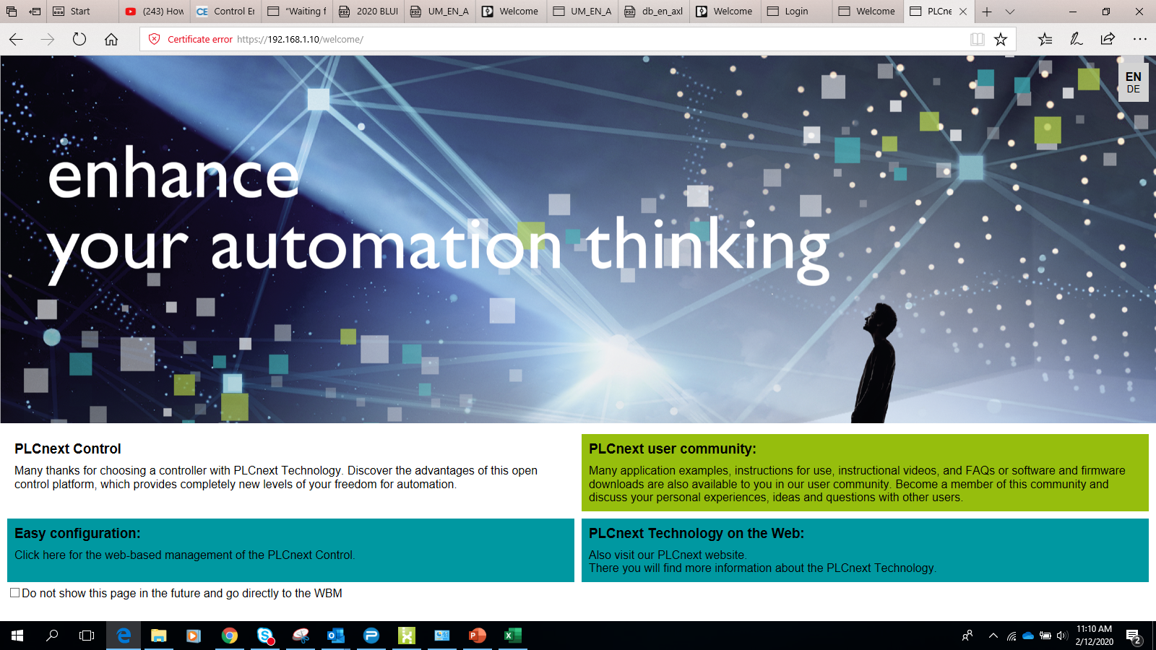
Access the PLCnext controller’s internal webpage
(Open a browser, type in: 192.168.1.10)
Note: You will get a warning from your browser that this may not be a safe site. It is safe. Proceed.

Slide 19

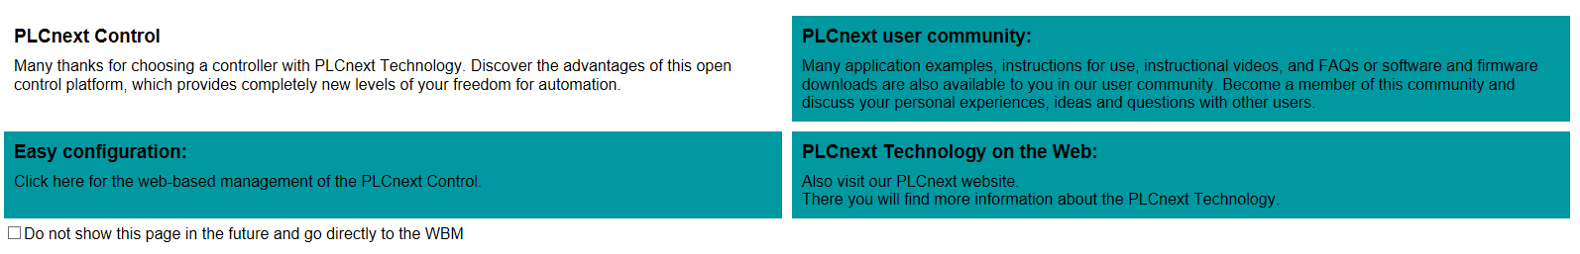
We will access the configuration pages. Skip to the end of this training for more information about the other links.
Click to access the web-based management configuration screens of the PLCnext controller
Click here to reach the PLCnext section of the Phoenix Contact website*
Thank you note
Click to access the PLCnext user community on the internet*
* Internet connection is necessary concurrently with your connection to the PLCnext controller. For example, WiFi connection to the internet, while the laptop’s Ethernet adaptor is attached to the PLCnext controller.
Notes:
This explains the layout of the starting screen of the

Slide 20
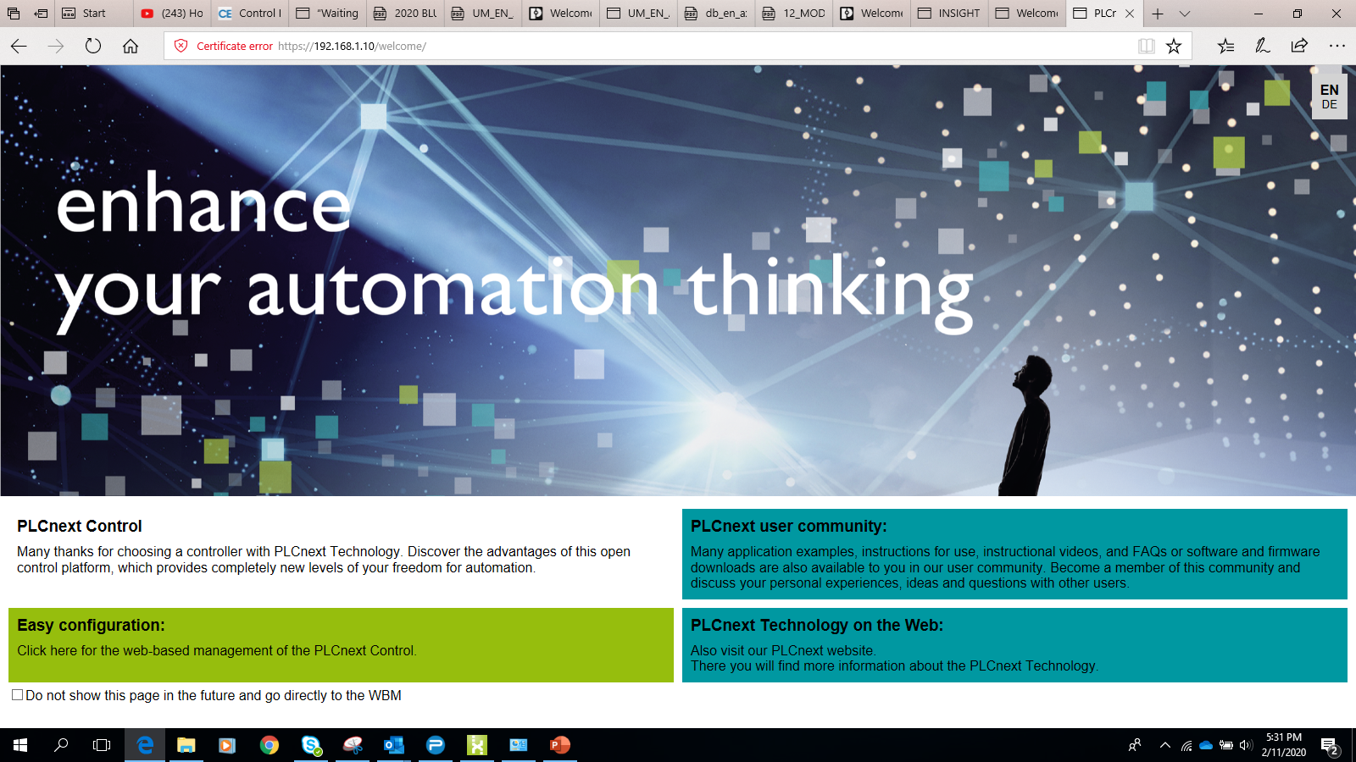
Click
Notes:
Moving the mouse over one of the three blue boxes will turn it green. Click on the “Easy Configuration” box to access the web-based configuration pages hosted on the PLCnext controller.
If you want to access the content linked to the other two boxes (“PLCnext user community” or “PLCnext Technology on the Web”) make sure you have internet access.

Slide 21
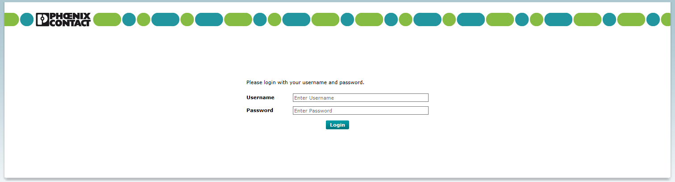
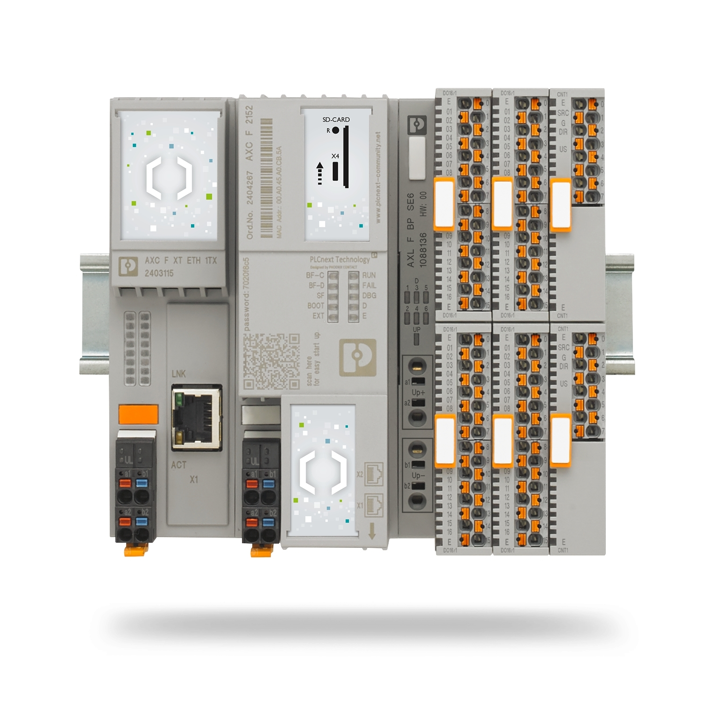
admin
(check the face of your unit)
The password to the PLCnext controller is found on the face of the unit, directly above the QR code.
This password is unique to each unit.

Slide 22
Note the firmware version of the PLCnext controller. Knowing this will help set up the project in PLCnext Engineering programming software. If the version is older than the PLCnext Engineer programming software, you’ll need to update the firmware

Slide 23
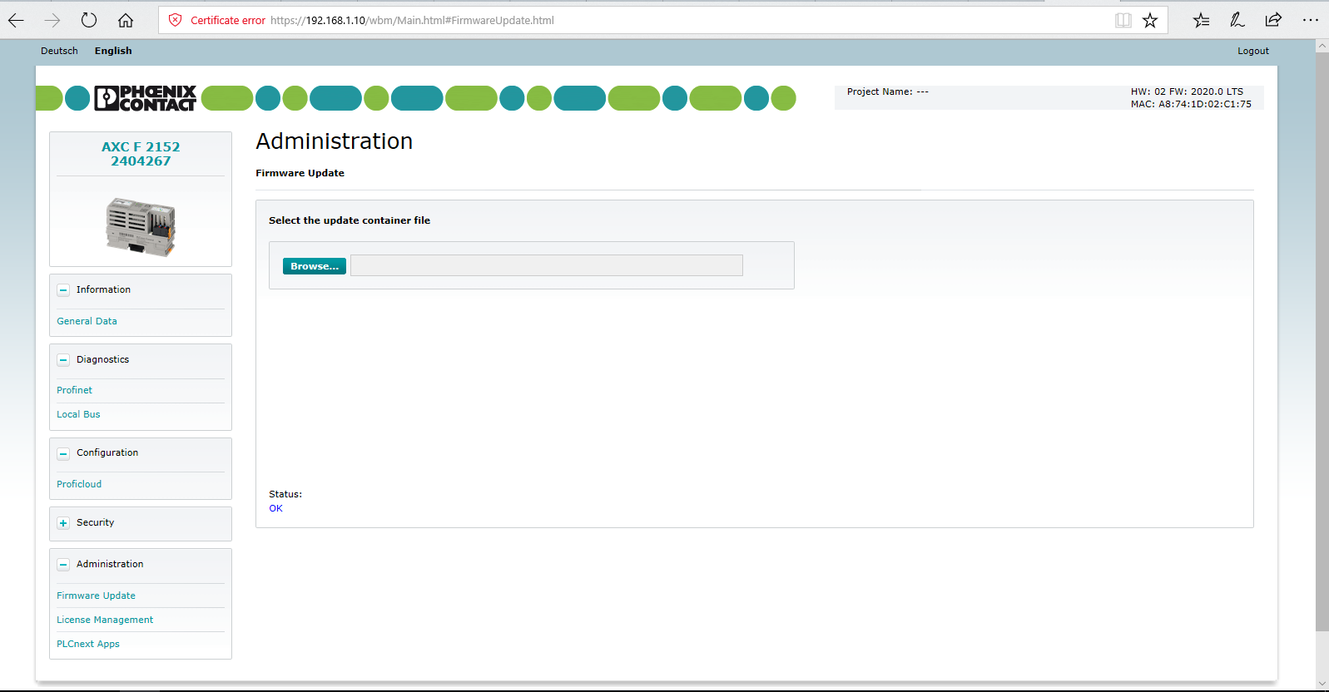
If a Firmware upgrade is needed, this page is accessed by clicking on the “Administration” menu item, and then on “Firmware update”. The latest Firmware file (as well as several older vintages) are found on the Phoenix Contact website, under the downloads section under the PLCnext product page. (This is accessible from the start screen of the PLCnext controller).
Notes:
Ensuring the PLCnext controller’s firmware version is the same as or newer than the version of PLCnext Engineer software being used to program the controller is critical in assuring proper communications between the software and hardware.

Slide 24
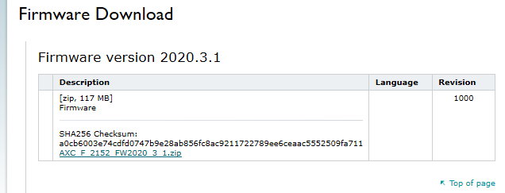
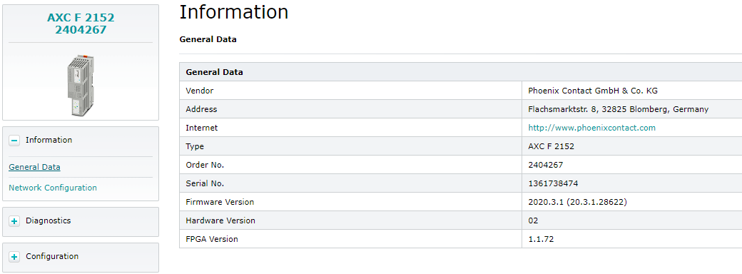

Verifying firmware revision
Access the appropriate product page on the Phoenix Contact website, navigate to “Downloads”, and download the latest firmware.
Once downloaded, unzip and RUN the executable. You will then see the appropriate firmware file to load on the PLCnext controller.
Once the firmware has been loaded, and the PLCnext controller has been rebooted, check the device’s web-based management to verify the firmware is up to date.
Notes:
There is no cost, and no license files to install.
Just download the software and install it like any other software.

Slide 25
Back to PLCnext Engineer
Having verified we have the proper firmware revision running on the PLCnext controller, you can leave the web browser open or close it.
Open PLCnext Engineer software.

Slide 26
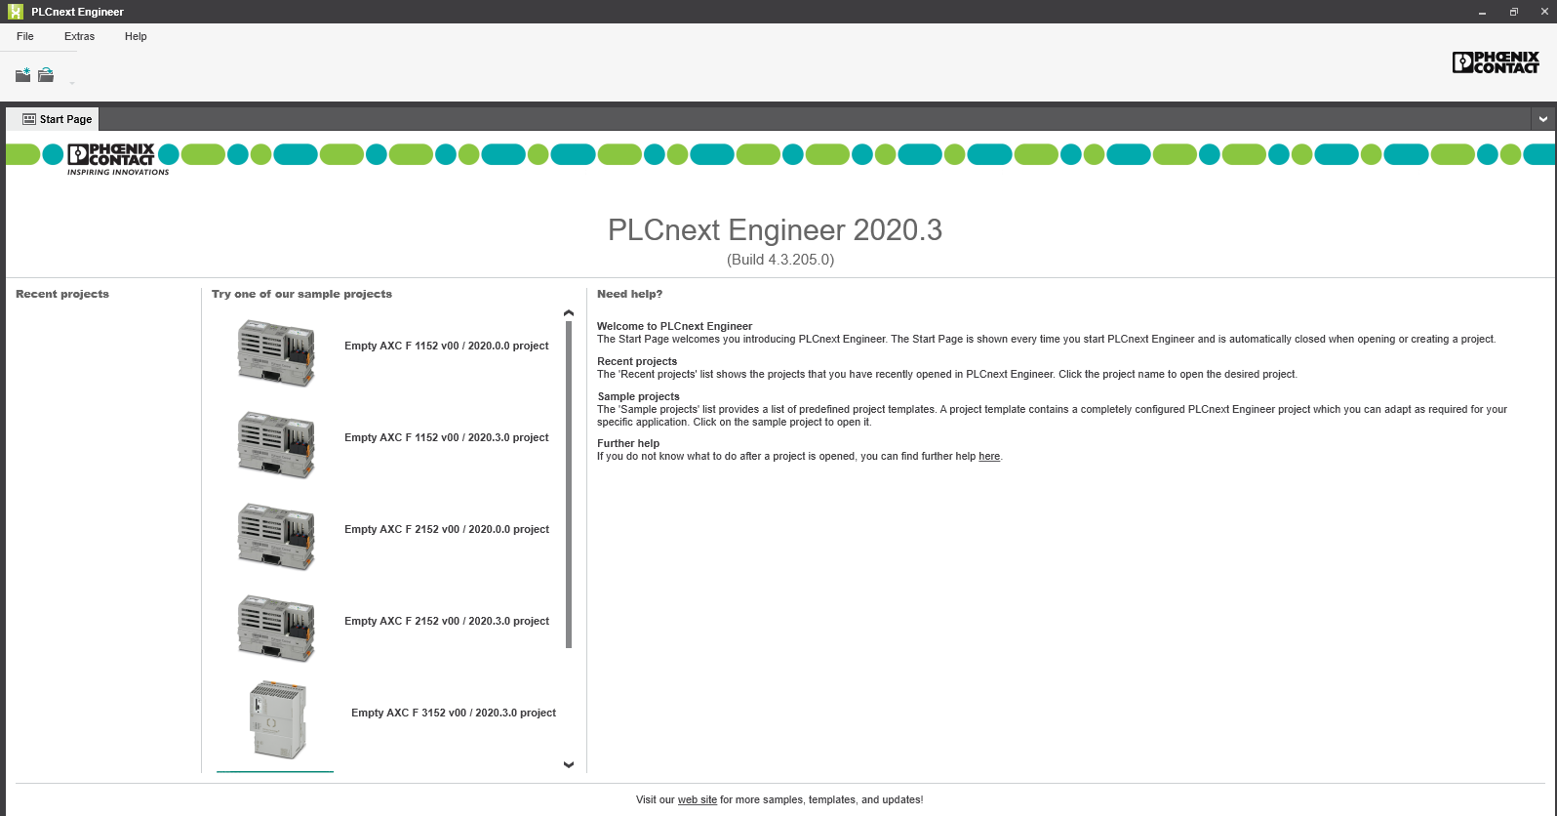
PLCnext Engineer
Opens to this start page
Load existing project from left section (not applicable until you have created and saved projects)
Start a new project from middle section, with a head start (be sure to choose correct hardware from list)
Help accessible from right-most section
Notes:
Note the version is listed in the headline at the top, right after “PLCnext Engineer” (version is 2020.0 in this example)
Note there is a link to the Phoenix Contact USA Corporate webite / PLCnext Technology / PLCnext Engineer software page at the bottom of the screen.

Slide 27
Creating a project in PLCnext Engineer
Get started by selecting one of the options in the middle section.
Match the hardware and firmware revision with the software’s revision (or make a selection with newer firmware than the software version you are using)

Slide 28
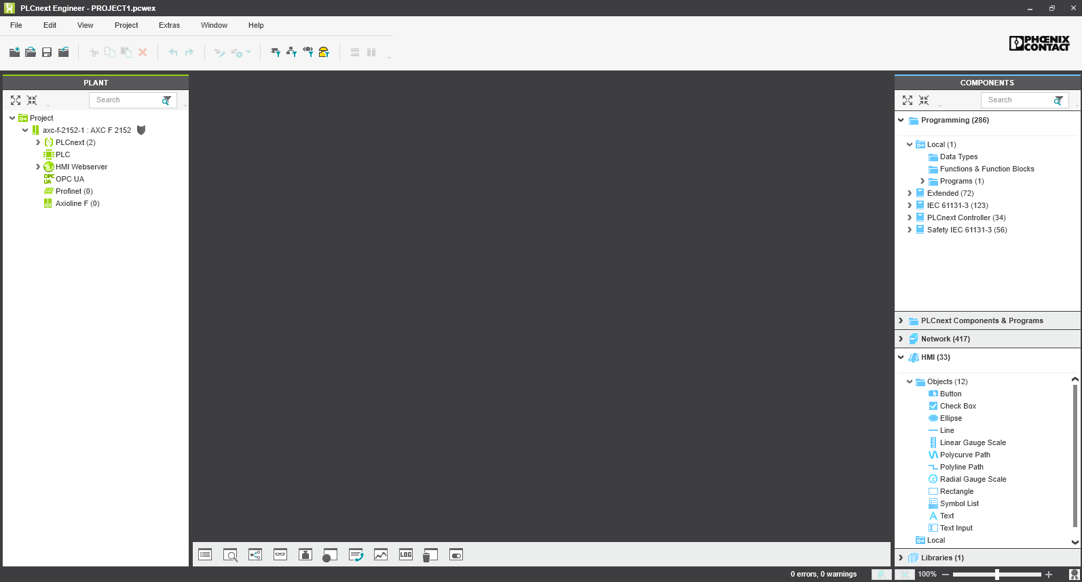
Initial setup
This will be the initial programming screen
Double Click “Project” under the “PLANT” section.

Slide 29
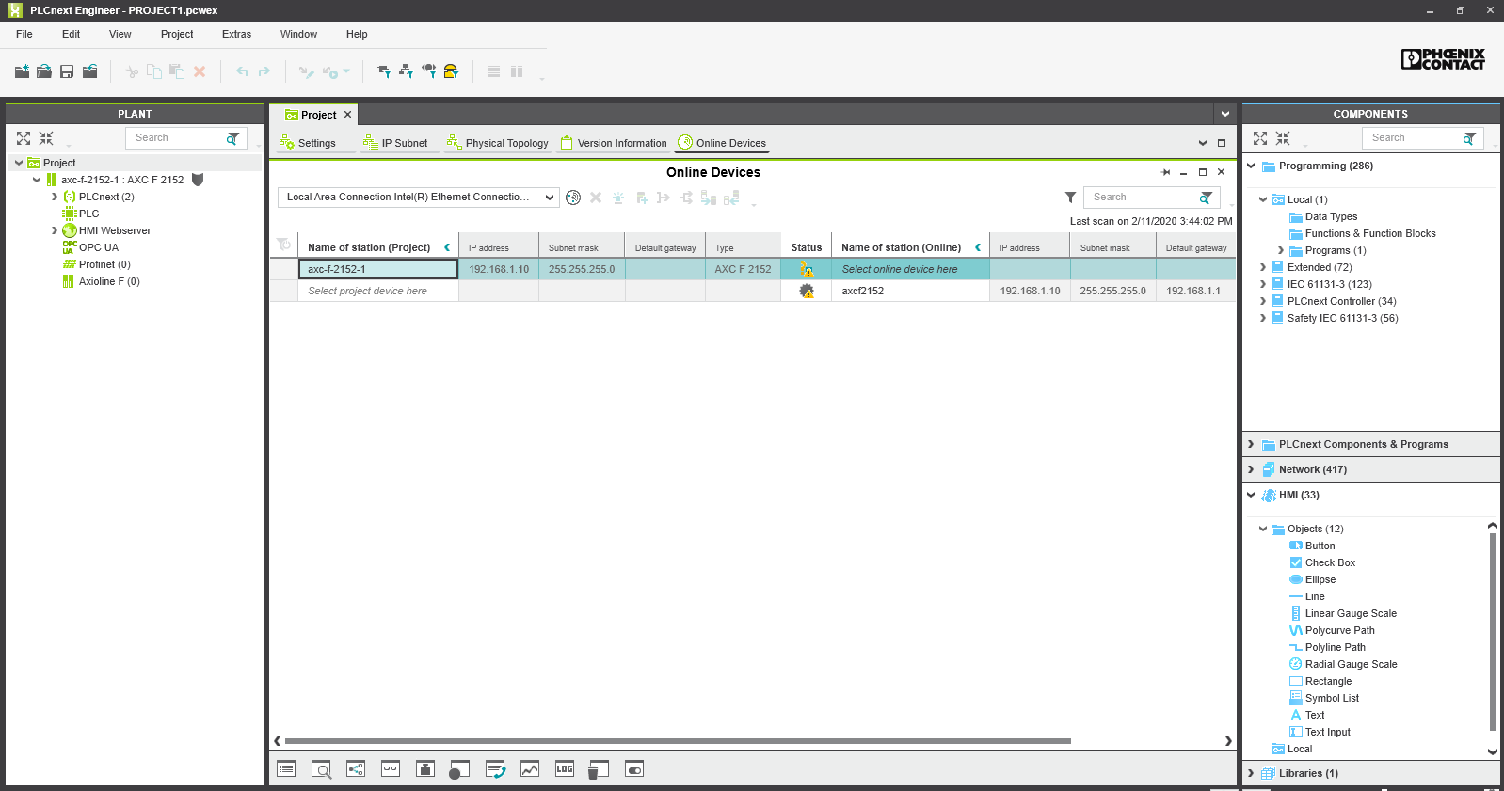
Align program communications with controller
Network scan icon
Click on “Online Devices” tab on the Project menu
Click in the blue box that says “select online device here”
Choose the device that is shown (in the 2nd row).
The two rows should then collapse to one, with the device from the second row shown in the “Name of station” column.
Click the symbol indicated by the arrow to scan the network.
Under the status column, there should now be a checkmark.
1
1
2
3
2
4
3
Note: If you had desired another IP address besides the default, you would make that change in the appropriate Project area in PLCnext Engineer. It would be shown and would take effect once the project was downloaded to the PLCnext controller.

Slide 30
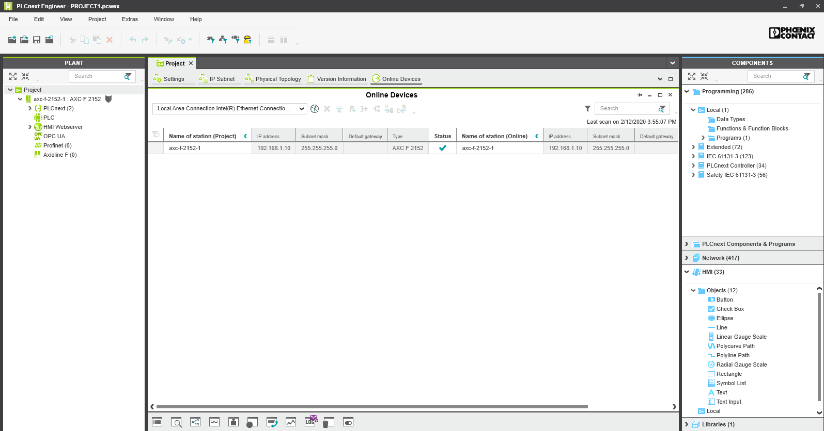
Align program communications with controller
Network scan icon
The two rows should then collapse to one, with the device from the second row shown in the “Name of station” column.
Click the symbol indicated by the arrow to scan the network.
Under the status column, there should now be a checkmark.
1
2
A
3
4
Note: If you had desired another IP address besides the default, you would make that change in the appropriate Project area in PLCnext Engineer. It would be shown and would take effect once the project was downloaded to the PLCnext controller.

Slide 31
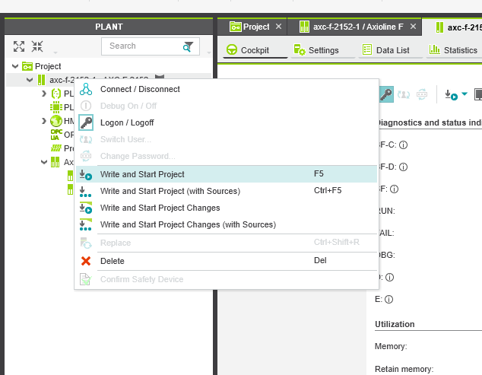
Downloading the project to the controller
Right-click the axc-f-2152: AXC-F-2152 to expose the dropdown menu
Click on “Write and Start Project” to download the project to the controller.
This will download the project, and hence the IP address to the PLCnext controller. Since we have not changed our IP address from the default, there is no need “Write and Start Project” at this point, but it is a task we will need to do often, so we might as well practice here.

Slide 32
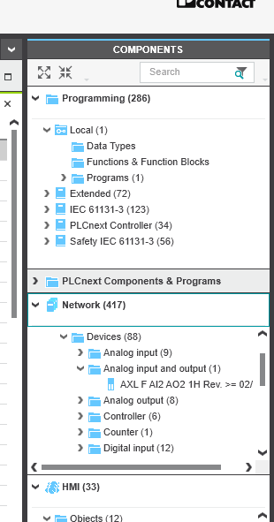
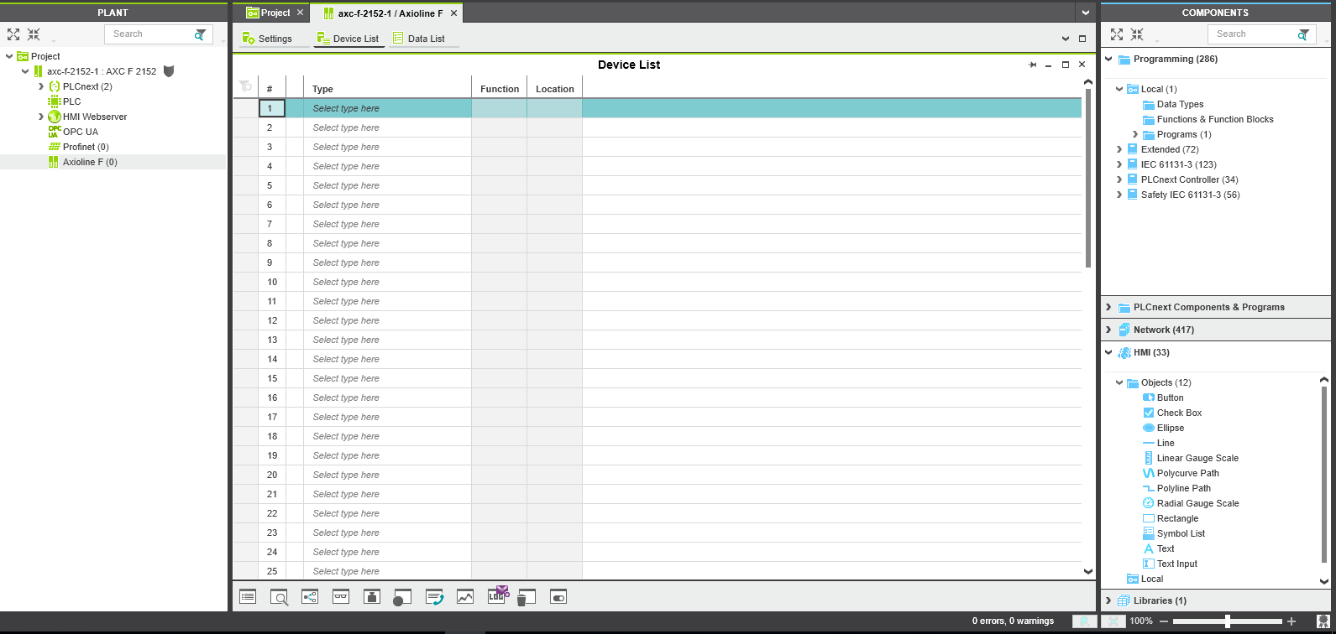
Select and add I/O modules
First, right-click and disconnect from the controller
Double click on “Axioline F” in the PLANT section
Click on “Device List” tab (notice the table is blank)
Under the COMPONENTS section, expand “Network” and the submenus until you find the module(s) you’ve added to the controller hardware.
Drag the modules and drop them on the “Axioline F” under the PLANT tree
OR click on the first unassigned row (see large arrow) and select module from the drop-down list that appears

Slide 33
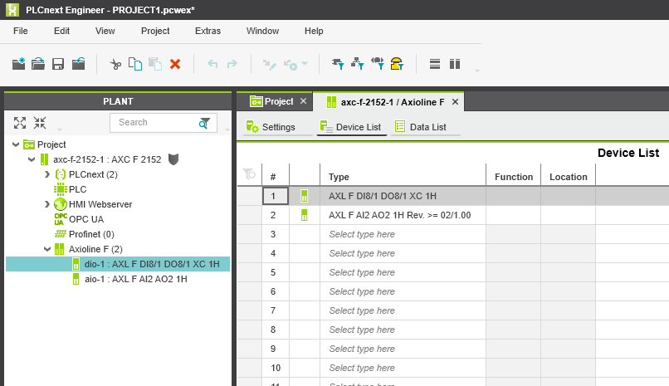
Verify that I/O modules have been added to program
Notice the relevant modules appear – nested under the “Axioline F” in the PLANT tree
And they are shown on the Device List in the middle of the screen.

Slide 34
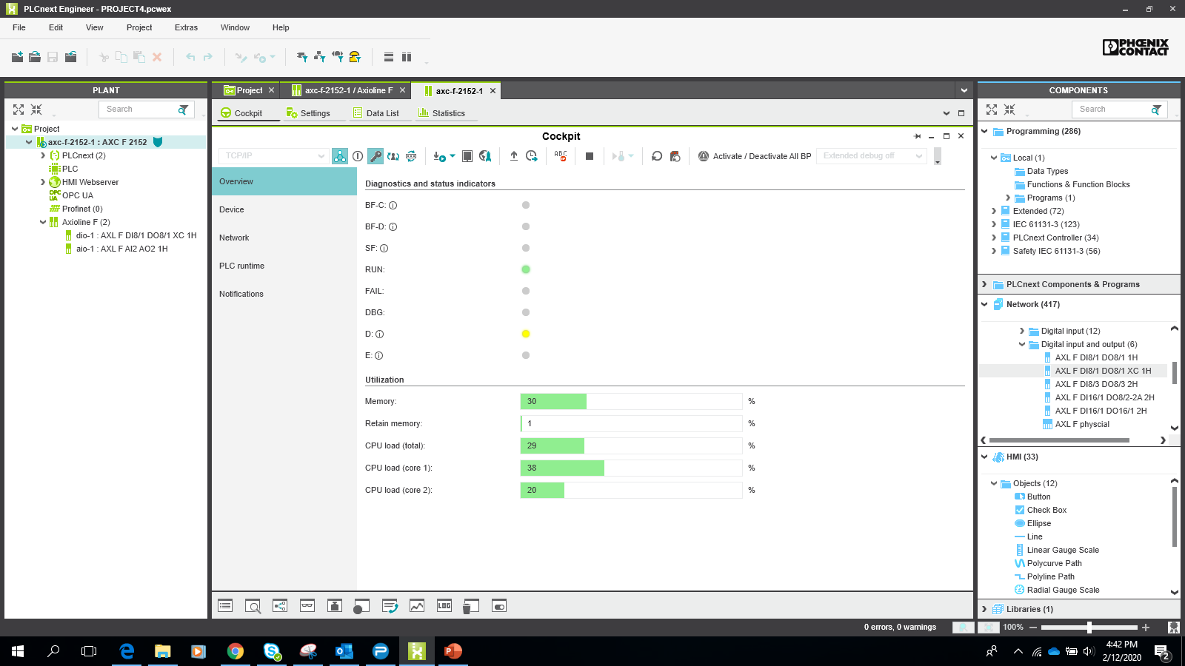
Verify connection between controller and software/program
Click on axc-f-2152: AXC-F-2152 directly under “Project” in the PLANT area
Verify the “Cockpit” tab is selected in the center workspace
Click on the triangular symbol next to the window that says “TCP/IP”
This should make an Ethernet connection between the controller and the program. You should see active diagnostics in the software that mirror those on the hardware.
2
1
3

Slide 35
Downloading the project to the controller
Right-click the axc-f-2152: AXC-F-2152 to expose the dropdown menu
Click on “Write and Start Project” to download the project to the controller.
You should notice that the “D” (diagnostic) LED on each of the I/O modules attached to the PLCnext controller are now blinking green rather than yellow.
  This indicates that (by downloading the program), the controller now recognizes the I/O modules attached to it.
  The blinking LED will turn solid green once all the I/O is assigned to variables in the program, or are disabled.
*Before proceeding to the next step,
right-click on axc-f-2152: AXC-F-2152 to expose the dropdown menu and click on “Connect/Disconnect to stop scanning.

Slide 36
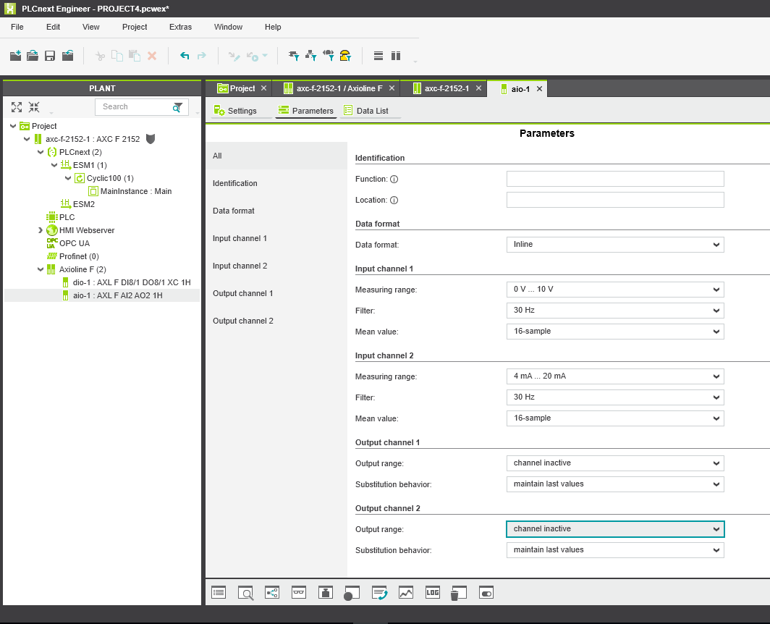
Parameterize the analog I/O
Double click on the analog module under “Axioline F” on the Project tree under the PLANT section.
I have 0-10 vdc analog input wired to analog input 00, and a 4-20mA analog input wired to analog input 01. There is nothing wired to the analog outputs.
Click the “Parameters” tab in the central workspace section, then select the appropriate measuring ranges for each input/output. (Make the outputs inactive, unless you have actuators to attach).
Click to save the project, through the File menu (as you would with any application).

Slide 37
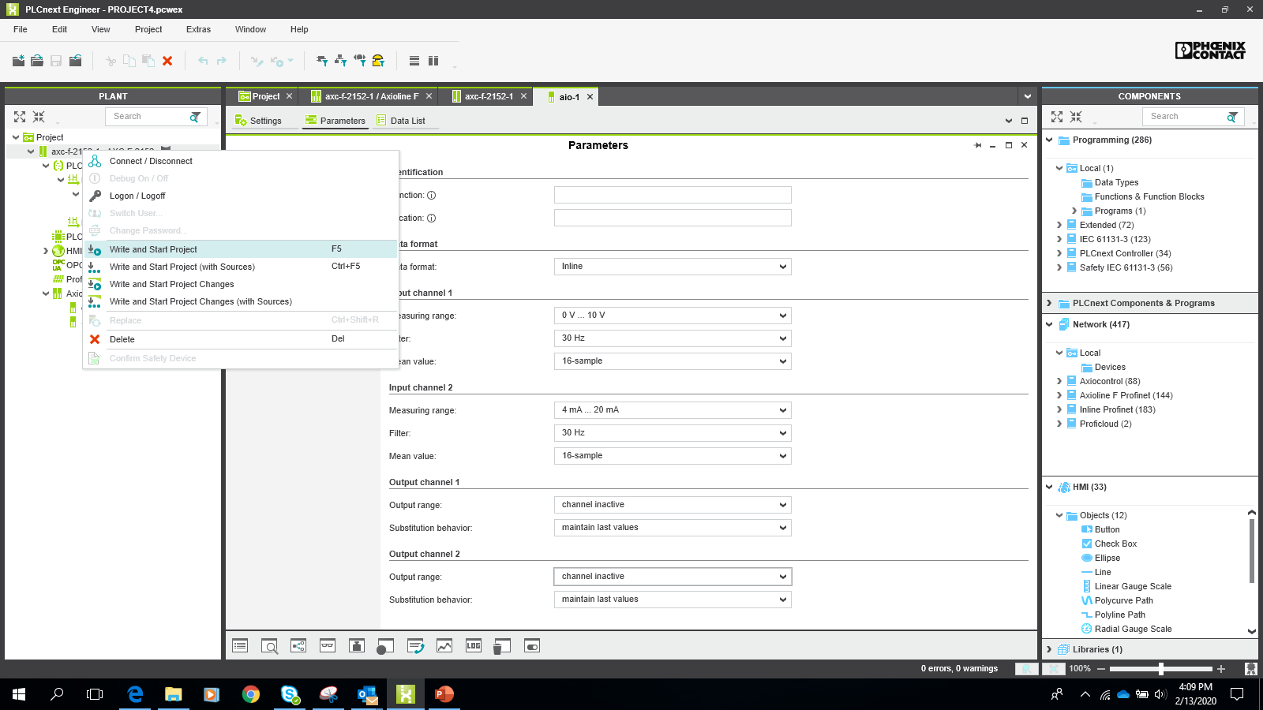
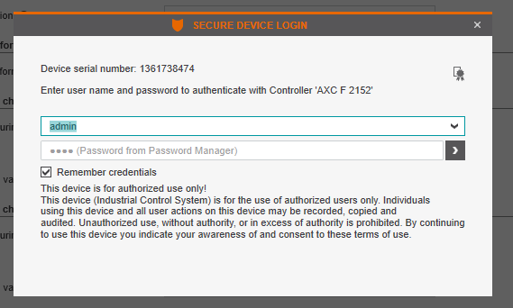
Download the project to the PLCnext controller
Right click on the axf-c-2152 – 1: AXF-C-2152 under Project
Select “Write and start project” from the drop-down menu to load the program onto the PLCnext controller, and to start the program running.
If you haven’t been online with the controller in a while, you will need to sign in. The username is admin
The Password is etched on the front of the PLCnext controller, above the QR code.

Slide 38
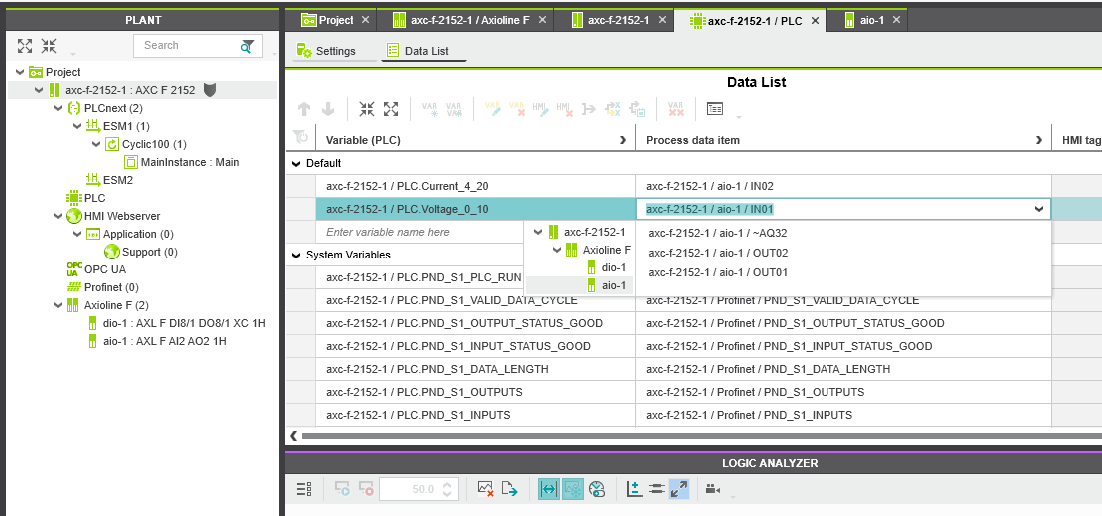
Create a variable for the program to use, link it to an I/O point on the controller
Double click on “PLC” under the project tree in the PLANT section.
From “Data List” tab, under the “Default” section under Variable (PLC), enter a variable name in the space that says “Enter variable name here” (I entered: “Voltage_0_10”. The rest was automatically prepended onto the variable name).
Click the dropdown arrow in the “Process Data Item field, and select the I/O point to associate to the variable
2
4
1
3
* If you cannot find the I/O point that you need (ie. the analogs aren’t displayed in the drop-down list), click on the circled arrow, to expose more columns in the data list. This will enable you to change the data type (for example, from BOOL to WORD), which will expose more I/O types. Select type WORD for the analog I/O to show in the drop-down list.

Slide 39
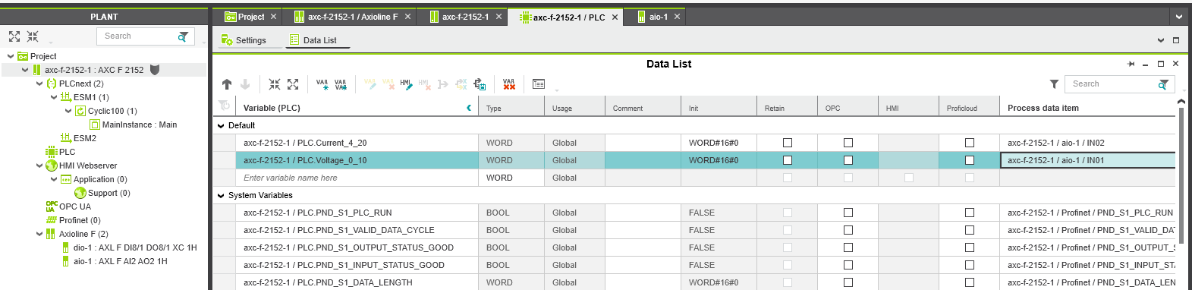
Create a variable for the program to use, link it to an I/O point on the controller
Note the Data List has expanded columns, with “Type” now to the right of “Variable (PLC)”
Click in the cell under “Type”, in the row of the variable you want to alter.
A pop-up menu of different data types will be visible. You can freely select from the various data types.
  Knowledge of programming conventions is necessary to understand which data types are appropriate for certain variables
  This knowledge is beyond the scope of this training.

Slide 40
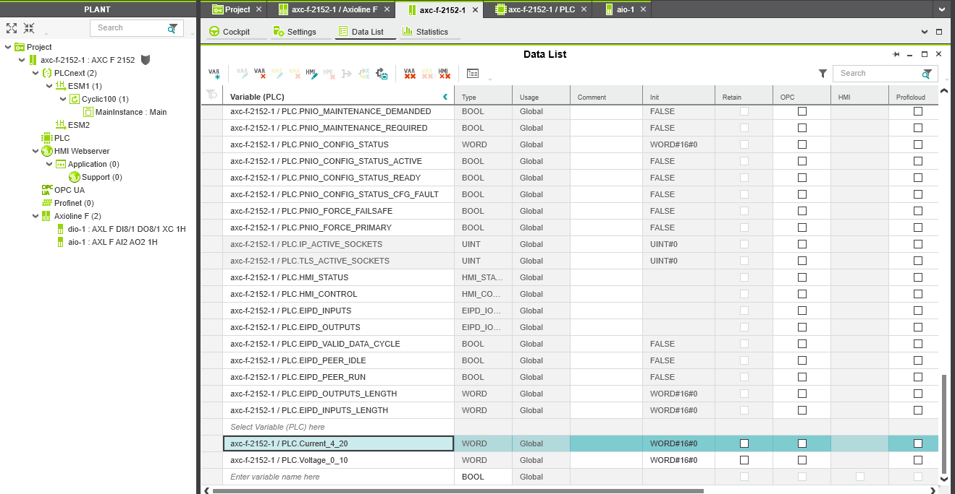
Prepare to download to the controller
Double click on “axc-f-2152-1 : AXC-F-2152” immediately under Project in the PLANT section
Make sure “Data List” is selected from the tabs
Locate the variable(s) you have added. (You may need to scroll down)

Slide 41
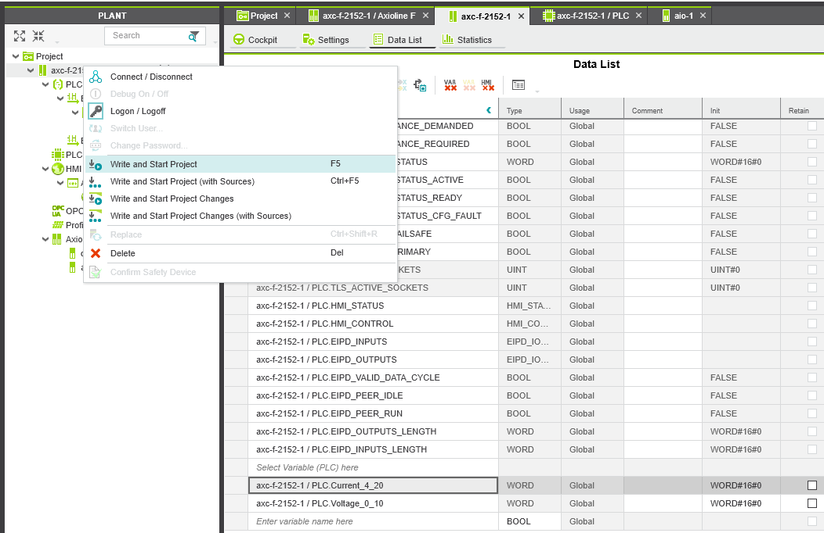
Prepare to download to the controller
Right click on “axc-f-2152-1 : AXC-F-2152” immediately under Project in the PLANT section
Click on “Write and Start Project to download and start the project on the PLCnext controller.

Slide 42
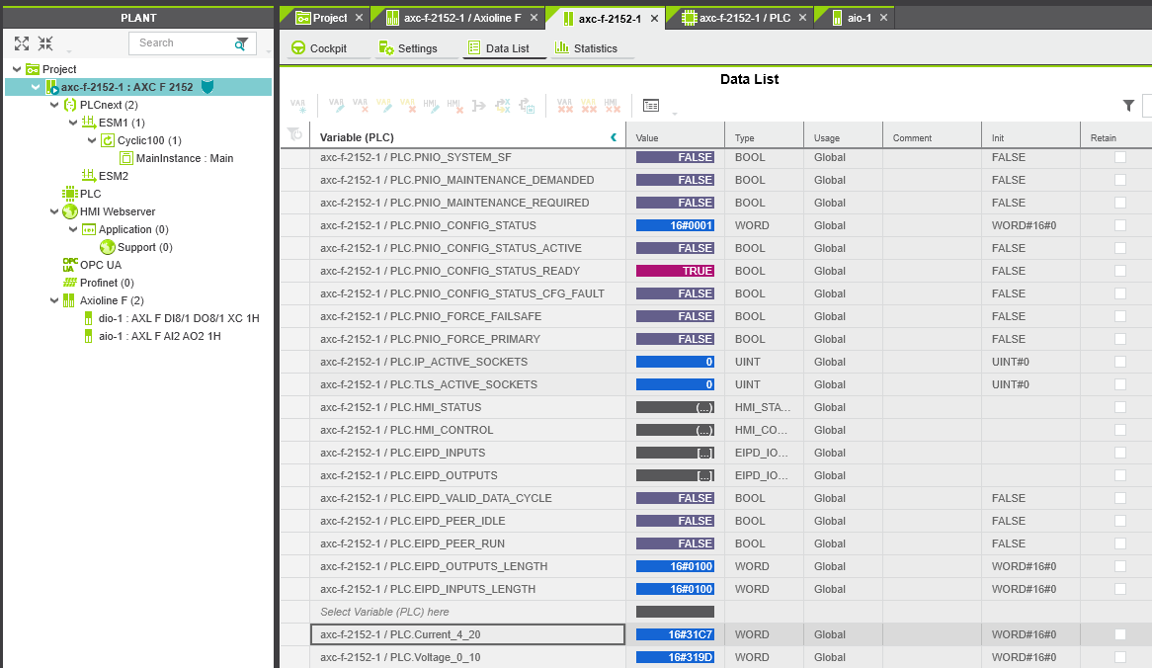
Witness interaction while online with PLCnext controller
Note the Data List becomes interactive as the PLC runs the program.
The raw values of the analog inputs can be seen (in hexadecimal format).
Twist the potentiometer and the values will change.

Slide 43
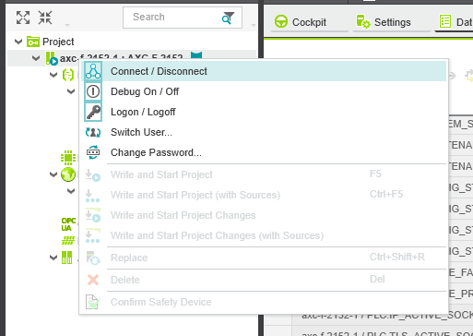
Prepare to do some programming
Raw variables won’t be of use in real-world applications. We will do some programming to scale those values to real-world engineering units.
First, Right click on “axc-f-2152-1 : AXC-F-2152” immediately under Project in the PLANT section
Then click on Connect / Disconnect (which will disconnect the program from the controller).

Slide 44
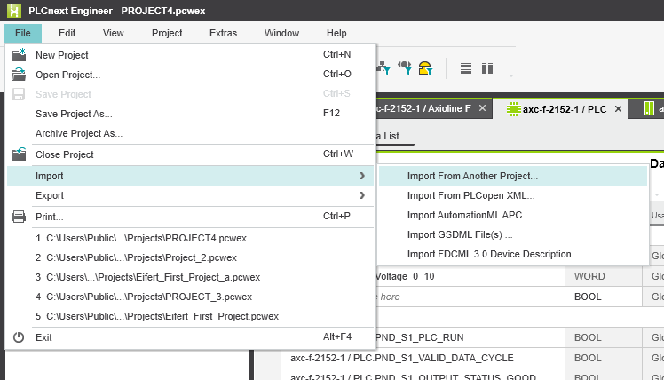
Prepare to do some programming
Because the programming to scale the inputs is fairly complex, and since someone else has already created a function block to perform this task, I will import their function block rather than build it from scratch.
It is located in another project “Project 2”.
From within the project we are working in, click File – Import – Import from Another Project

Slide 45
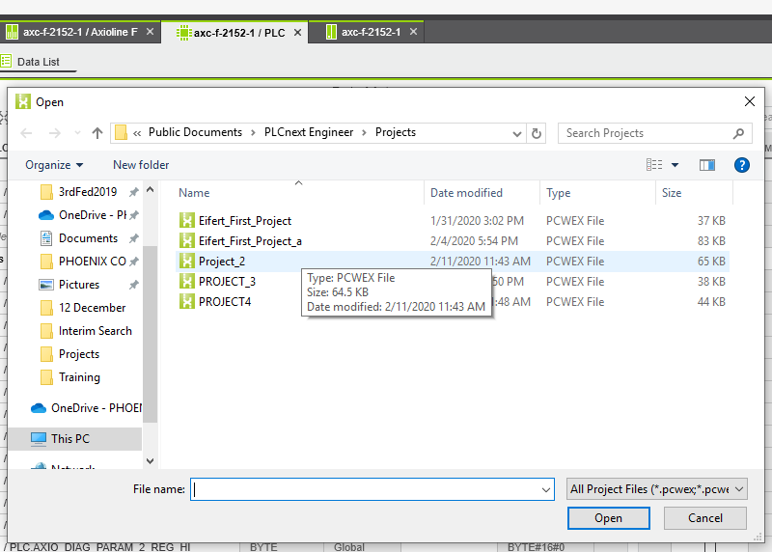
Import from the selected project
Locate the existing project which contains the function block you need
In this case, I know the function block I need is in the “Project_2” project

Slide 46

Only select the content you want to import
All items are selected by default, since we only want the “AI_Norm” function block, deselect everything and select just the “AI_norm” by checking its box.
Click OK

Slide 47

Function block is added to our project
Notice this new function block has been added to our new project.
In the COMPONENTS section, under Programming/Local/Functions & Function Blocks/Internal Functions
We now have the desired function block to scale our raw value: AI_Norm

Slide 48

Opening a program, so we can begin programming…
We’ve started a Project, we have added, and configured I/O, we have set up communications between the project and the PLCnext controller. Now we can begin to program.
Still in the COMPONENTS section, under Programming/Local/Programs, double click on “Main” to open this blank new program.

Slide 49

Getting ready to program
You will see a new window open in the central working area
The tab will have the program’s name “Main”, and the “Code” sub-tab will be selected

Slide 50

Selecting a function block
Drag and drop the “AI_Norm” function block onto the work surface.
  Note, this training was developed prior to the development of the newest AI_Norm and AO_Norm function blocks…the current versions contain a few more parameters to aid in scaling the proper engineering units.

Slide 51

Programming using the AI_Norm function block
The purpose of this function block is to take the raw analog signal coming from the I/O exerciser, and giving it a high and low level, and scaling its raw signal to a “real-world” engineering value.
I have already completed parameterization of one input (below) and will now show step-by-step how to configure the second one.
Position the cursor near the black square near “xEnable”
Double click and type “TRUE” and return (this will enable this function block in the program)

Slide 52

Programming using the AI_Norm function block
3 – On the left side position the cursor near the black square at xSetZero and double click. Type in “Set_Current_Min”. This is the name of a new variable.
4 – Click on this newly created variable, the field will turn blue. Select VAR E from the list above the variable to make this an External Variable
5 – Repeat steps 3 & 4 for “xSetSpan”, calling this new variable “Set_Current_Max”
6 – Repeat steps 3, 4 & 5 for the signals on the right side.

Slide 53

Programming using the AI_Norm function block
7 – repeat steps 3 & 4 for “wPD_Input”, calling this new variable “Current_4_20”
8 – repeat steps 3 & 4 for “rValue”, calling this new variable “Scaled_Current_Value”
9 – Think about what you want this 4-20mA signal to represent in the real world. Let’s say it represents a flow meter, and the flow can be between 0 gpm and 400 gpm…
10 – Double click on “rMin” and type in 0.0
11 - Double click on “rMax” and type in 400.0

Slide 54

Checking that the variables have been properly assigned
Click on the “Variables” subtab to verify that all the new variables you have declared, have in fact been assigned.
If not, you probably forgot to click in the variable once you first created it, and then chosen to associate it to “VAR”, VAR E”, etc. from the menu above the variable tag.
If variables have not been assigned, there will be an error message at the bottom of the screen.
Save the project

Slide 55

Let’s confirm everything works so far…
Right click on “axc-f-2152 – 1 : AXC-F-2152” below “Project” in the PLANT section.
From the drop-down menu, select “Write and Start Project”
This will send our newly created program to the PLCnext controller and start running the program. It will take a minute or so.

Slide 56

Let’s confirm everything works so far…
Double click on “axc-f-2152 – 1 : AXC-F-2152” below “Project” in the PLANT section.
Click on the “Data List” Subtab in the central working space
You may need to scroll to the bottom to find the scaled analog input variables we recently created
Note, when the potentiometer is turned all the way up, the max-scale values appear as we have parameterized! Success!
Twist the knob, and see those values change.

Slide 57

Disconnect from the controller to enter programming mode
First, we must disconnect from the PLCnext controller
Right-click on “axc-f-2152 – 1 : AXC-F-2152” below “Project” in the PLANT section.
The click on Connect / Disconnect to disconnect
Let’s make it interesting and activate two digital outputs when our scaled analog input values reach some thresholds.

Slide 58

Let’s turn on a digital output, based on the value of one of the scaled analog inputs
Expand the Programming tree in the COMPONENTS are as shown to the right.
Drag the GT (Greater Than) comparison block onto the programming area (make sure the “Main” (program) tab is selected and the “Code” subtab is open, so you can see the programming workspace)

Slide 59

Using a Greater Than comparison function block
Note I have already done the programming to turn on Output_1 when the Scaled_Current_Value exceeds 300.0 (Gallons per minute)
Now we will activate another digital output when the Scaled_Voltage_Value exceeds a threshold.
Repeat the steps that follow to go back and program the Greater Than function block for the Scaled_Current_Value.

Slide 60

Connecting the GT block to the Scaled_Voltage_Value variable
Click on the top/left red square of the “GT” function block and drag a line to the “rValue” junction on the AI_Norm1 function block, and release
Double click on the bottom/left red square of the “GT” function block and type in the threshold value. I will use 21.5 (feet)

Slide 61

Programming Digital I/O
Double click on the black square on the right side of the “GT” function block and type in a new variable name. I will use “OUTPUT_2”
Click on this new variable and then select “VAR E” from the menu directly above to make this an external variable.
Now we will need to link this newly created variable to a real physical output on the PLCnext controller

Slide 62


Linking a variable to a real I/O point on the PLCnext controller
Double click on “axc-f-2152 – 1 : AXC-F-2152” below “Project” in the PLANT section.
Click on the “Data List” sub tab
Scroll down to find this newly created variable “OUTPUT_2”
Click in the box where is says “Select process data item here” next to the newly created variable.
Choose the Digital Output you want from the drop-down list
(I’ll pick …OUT2)
Click save to save the project

Slide 63
Let’s test to see if the program works
Right click on “axc-f-2152 – 1 : AXC-F-2152” below “Project” in the PLANT section.
From the drop-down menu, select “Write and Start Project”
This will send our newly created program to the PLCnext controller and start running the program. It will take a minute or so.

Slide 64

Let’s confirm everything works so far…
Double click on “axc-f-2152 – 1 : AXC-F-2152” below “Project” in the PLANT section.
Click on the “Data List” Subtab in the central working space
You may need to scroll to the bottom to find the scaled analog input variables we recently created
Twist the knob and verify that Outputs 1 And 2 switch from False to True at the appropriate threshold values.

Slide 65

Let’s test to see if the program works
Switch screens to see an alternate view.
Go to the “Main” tab, and the “Code” sub tab.
Click on the arrow to sync the programming environment with the online execution in the PLCnext controller

Slide 66

Let’s test to see if the program works
Switch screens to see an alternate view.
Go to the “Main” tab, and the “Code” sub tab.
Click on the arrow to sync the programming environment with the online execution in the PLCnext controller.

Slide 67
Programming the HMI
PLCnext Engineer has a built-in Human-Machine Interface (HMI) editor. The HMI pages that are created are downloaded onto the PLCnext controller which then serves them in HTML5 format to any connected device with an internet browser.
Display the web-based HMI pages on
  Laptop, desktop computer
  Tablets, smartphones
  HTML5 capable panel-mounted HMI operator interface screens

Slide 68

Getting started with HMI programming
Click on “HMI Webserver” in the Project tree in the PLANT section.
Go to the “HMI” section in the COMPONENTS area and expand the tree.
Expand “Default” and then “Page templates”
Find the “Blank Page” template. Drag it and drop it on “Application” in the Project tree in the PLANT area. (See next slide).

Slide 69

Ready to start programming the HMI
You now have a blank page that is ready for objects to be drawn and linked to the program.

Slide 70

Adding an object (symbol) to the project
Since one of our analog inputs is a level sensor, it makes sense to use a vertical gauge as one of our symbols
Drag and drop the symbol to the workspace

Slide 71

Programming the HMI
Click on this symbol so the configuration box displays.
Click on the “Parameters” tab at the bottom of the configuration box
Click in the “Source Value” box
Since “Scaled_Voltage_Value” is the variable that represents level, select it.
Now click on “Settings” at the bottom of the configuration box.

Slide 72

Configuring the HMI object
Change the “Scale.Properties.Scale range” / “Scale maximum” to match (or approximate) the range of the input (which is 0-25 (feet)).
Scroll down and change “Needle.dynamic.path” to match the value you enter for “scale maximum”.

Slide 73

Disabling security on web-HMI (for demo)
To avoid the need to add password protection to access the Web HMI, access the tab shown by double clicking on “HMI Webserver” in the Project tree in the PLANT area.
Select “None” for Enforcement of user levels

Slide 74

Simplify the HMI application by eliminating the login provision.
Right click on the “Login” entry under “Application”
Select “Delete” from the menu.
This will remove the need to program the screen to include a sign-on interface, and for the user to log in every time.
When you delete the “login” page, the error will go away.

Slide 75

Check out the functioning HMI
Double click here:
Click on the “Cockpit” tab.
Click on the icon that looks like a tablet (to the left of the rocket icon).
This will launch the default web browser to let you see the “runtime” version of the HMI page we are creating.

Slide 76

View the HMI page, interact with it
You will likely get an error warning you to avoid this webpage. The “web” page is internal to the PLCnext controller and it is safe.
Navigate to the page, despite the warning. (This warning screen will look slightly different based on the internet browser being used.

Slide 77

View the HMI page, interact with it
You will likely get an error warning you to avoid this webpage. The “web” page is internal to the PLCnext controller and it is safe.
Navigate to the page, despite the warning. (This warning screen will look slightly different based on the internet browser being used.
Twist the potentiometer now and watch the needle move, corresponding to the analog input representing level!

Slide 78

Get back into the PLCnext Engineer programming environment
Once you are back in PLCnext Engineer, Right click on
And disconnect from the PLCnext controller.
Double click on “Page” on the Project tree in the PLANT area, and make sure the “HMI Page” sub tab is selected.
You should be back to the HMI development environment as seen on the next slide.

Slide 79

Add another symbol – to represent the other analog input
Since the other analog input represents a flow rate, it makes sense to use an analog dial gauge.
Use the same process as with the vertical gauge to drag and drop it into the workspace.
From parameters tab, assign “Scaled_Current_Value” as the variable.
Using the same methods when configuring the other symbol, configure this gauge.

Slide 80

Configuring the rotary gauge HMI object
Your configuration should look something like this.

Slide 81
Check out the functioning HMI
Double click here:
Click on the “Cockpit” tab.
Click on the icon that looks like a tablet (to the left of the rocket icon).
This will launch the default web browser to let you see the “runtime” version of the HMI page we are creating.

Slide 82

Review the HMI runtime…
The HMI is displayed as we would expect
Turn the potentiometer and the level will rise and fall, as the pressure increases and decreases
Note: the pressure gauge shows the numerical value and the units of measure beneath the gauge. Let’s add these to the vertical gauge.

Slide 83

Adding text to the HMI page
From the COMPONENTS section, under HMI, click on “Text” and drag it onto the work surface, then release.
Double click on the object on the screen (textbox with the word “text”)
The configuration window will appear (as shown).

Slide 84

Configuring text dynamics
In the configuration window, click on the “Dynamics” tab at the bottom.
Click on “New dynamic” and select “Text” from the drop-down menu.
Next click next to “variable” and select the “Scaled_Voltage_Value” since that is what will correspond to the gauge’s value. Hit the ENTER key

Slide 85

Configuring text dynamics
In the configuration window, click on the “Dynamics” tab at the bottom.
Click on “New dynamic” and select “Text” from the drop-down menu.
Next click next to “variable” and select the “Scaled_Voltage_Value” since that is what will correspond to the gauge’s value. Hit the ENTER key
Indicate the number of places after the decimal that you want to display.

Slide 86

Further configuration of the text object
Click on the Text tab at the bottom of the configuration window
Under the “Text” section, click the down arrow near the font style is indicated
Choose the color of the test to be displayed. I am choosing orange.
You can change the font size and style here too.
Click on the object, drag and drop beneath the vertical gauge.
Save the project.

Slide 87

Create an object to show the units for this variable.
Since we are measuring level, something like “Feet” would be good.
As before, choose “text” from the COMPONENTS section under “HMI”
Drag and drop it under the last object, and enter the text “Feet” that you want to display
Alter the text to your liking (color, size, font, etc.)
Save the project, download to the PLCnext controller, and open the webpage to view.

Slide 88

Two analog gauges, complete in HMI

Slide 89

Adding some digital inputs / outputs
We will add some digital inputs, and then some outputs.
On the physical side, we will wire some of the PLCnext controller’s digital outputs to some of its digital inputs, so when an output turns on, a corresponding input will simultaneously turn on
Earlier we programmed DO 1 and 2 to each turn on based on the values of the current and voltage inputs.
Note: I added black fill to the background for aesthetic reasons.

Slide 90


Creating “indicating lights” to show DI status
Drag and drop an “Ellipse” object from the HMI menu under the COMPONENTS section.
This will make a circle which will function as an indicator light which we will configure to “light up” when the corresponding digital input is turned ON.
Since we have 8 digital inputs, copy and paste this object to make 8 circles, and arrange them as you desire.
Simply use control C, control P to replicate the circles.

Slide 91

Adding dynamics to turn on and off the indicator lights based on digital input state
Double click on one of the circles
Click on the Dynamics tab

Slide 92

Adding dynamics to turn on and off the indicator lights based on digital input state
Double click on one of the circles
Click on the Dynamics tab
Click on “New Dynamic”
Click on “Color or Fill” from the drop-down menu, and click on “Fill”

Slide 93

Adding dynamics to turn on and off the indicator lights based on digital input state
Double click on one of the circles
Click on the Dynamics tab
Click on “New Dynamic”
Click on “Color or Fill” from the drop-down menu, and click on “Fill”
Choose a variable to associate with this button, Input_0
Make the fill a dark color when the condition is false, and a bright color when the condition is true. (light turns “on” when digital input is turned on)

Slide 94

Adding/configuring the variables in the Data list
Configure each input “indicator light” the same way. Just changing the Variable for each…Input_1, Input_2…Input_8
(You could create any variable name you desire...maybe something more descriptive, like Pump 1 running, or dosing pump On….)
You can create variable names in the HMI environment.
You will need to define them and link them on another screen.

Slide 95

Adding/configuring the variables in the Data list
Navigate to the “Data List” tab by double clicking here and choosing the “Data List” sub-tab
If the list is expanded, contract it by clicking here (the arrow should be pointing to the right)
Scroll to the bottom, add the variables you created on the HMI page by clicking and entering them here
Associate each variable with a Process Data Item as shown

Slide 96

The HMI screen with digital input indication
Earlier in this training, we had created two Greater Than comparison function blocks. When the analog inputs exceeded certain thresholds, they would turn on Digital Outputs 1 and 2, respectively.
I have cranked up the potentiometer so that both outputs have turned on
You’ll note that digital inputs 0 and 6 have turned on.
(I wired DO1 to DI0, and DO2 to DI6 on the PLCnext controller)

Slide 97

Adding a counter and reset to program/HMI
Get back to the Project and the “Main” (program) tab, and the “code” sub-tab.
Expand the Programming tree as seen in this screenshot and drag and drop the CTU (counter – up) function block onto the work surface.

Slide 98

Programming a counter-up function block
This counter will count the number of times the high-level alarm is reached. We have a digital output which we have already programmed to turn on when the “Scaled_Voltage_Value” variable (which represents tank level) reaches a certain value (21.5 feet). That digital output is called “OUTPUT_2”.
Double-click on the “CU” element. Type in “OUTPUT_2” . Every time Output two turns on, the counter will increment up by one.

Slide 99
Programming a counter-up function block
Double click on “Reset” and type in “High_Level_Reset”. This is a new variable that we will have to define. It is on that we will use to reset the counter. (By clicking on a button on the HMI).
Make sure you declare this new variable as a VAR E (External variable) from the menu items on this screen.
Double click on “PV” and enter a value such as 32000. It just needs to be a high number so the counter doesn’t reach this number and stop counting.
Double click on “CV” This is the counter value. Enter “High_Level_Counter” This is a new variable that keeps track of the count. Declare it as a VAR E on this screen.

Slide 100

Adding/configuring the variables in the Data list
Click on the “Variables” sub tab*.
Make sure you designate the “High_Level_Counter” as an INT (integer) Type, and the “High_Level_Reset” as a BOOL (Boolean) Type.
These make sense since the counter will be able to produce an integer, and the reset will either be true or false.
Save the project.
* Or choose “PLC” from the project tree in the PLANT area, and manipulate the variables via the Data List tab.

Slide 101

Representing the counter in the HMI
Get back to the HMI development screen.
We will use two text objects and one button object.
Click and drag a “Text” object onto the work surface
Double click it to open the configuration window

Slide 102

Configuring text associated with the counter
Make sure you are on the Text tab (bottom of the window).
Type in “High Level Counter” in the text field
Click on format and format the text as you wish (refer to earlier section in this training if necessary)
Enter
Save project

Slide 103

Configuring text associated with the counter
Click and drag a “Text” object onto the work surface, to the right of the last one.
Double click it to open the configuration window
Go to the “Dynamics” tab
Click “New Dynamic” and select “Text”
Assign the “High_Level_Counter” variable as shown.
Go to “Text” tab (at bottom) and format the text with the color, size, style you desire.
Hit Enter and then Save the project

Slide 104

Configuring text associated with the counter’s reset button
Drag and drop a “Button” object onto the work surface (near the text we just configured).
Double click on it to open the configuration window.
We’ll add two new dynamics to make this reset button function.

Slide 105

Adding dynamics to the reset button
Add a New Dynamic – “Action on Pressed” and configure as shown to the right.
Add a New Dynamic – “Action on Released” and configure as shown to the right.
Click to save the project as you would for any program (File/Save)….

Slide 106

Download and test the HMI
As we have done before, download the project to the PLCnext controller, and start execution of the program.
*Then go to the “Cockpit” sub-tab and click the icon (that looks like a tablet) to go to the browser to check out the runtime version of the HMI
* Or simply open your internet browser, and type in the IP address of your PLCnext controller.

Slide 107

Viewing and interacting with the HMI
Success!
Try cranking up the potentiometer until it exceeds 21.5 feet and see if the counter increments up by one each time.
Then click on the button. Does the count reset to 0?
And as you begin cranking up the level – does it resume counting?
If so, you did everything correctly!

Slide 108
Let’s make some HMI buttons that turn on actual outputs on the PLCnext controller
So far, we have turned on two digital outputs by doing some programming such that when one of two analog inputs reaches a prescribed value, the corresponding digital output turns on.
We have also created a button that resets an internal variable representing a counting function.
Let’s combine elements of these two concepts and create some virtual pushbuttons in the HMI that, when pressed, will directly turn on some digital outputs.
Since DO1, and DO2 are already in use, lets use DO5, DO6, DO7, and DO8 for this exercise.

Slide 109

Create and define the digital output variables
First, let’s create the variables and map them to the PLCnext controller’s digital outputs
Follow the example shown to the right
Click the right arrow symbol (>) in the header of the Variable column to expand this table.
Verify that all the newly created variables are of Type: “BOOL”

Slide 110

Adding virtual pushbuttons to the HMI
We’ll end up making eight (8) buttons, a Start, and a Stop for each of four “pumps”
You can choose a color scheme for your buttons, and arrange them as you see fit

Slide 111

Adding and configuring pushbutton HMI objects
Drag and drop a “Button” object onto the work surface.
Double click on it to open the configuration window

Slide 112

Adding and configuring pushbutton HMI objects
Drag and drop a “Button” object onto the work surface.
Double click on it to open the configuration window
On the button tab, configure as seen to the right (you may elect to use “Start” instead of “Turn On”, etc.)

Slide 113

Adding and configuring pushbutton HMI objects
Drag and drop a “Button” object onto the work surface.
Double click on it to open the configuration window
On the button tab, configure as seen to the right (you may elect to use “Start” instead of “Turn On”, etc.)
Scroll to the bottom of this window if you want to change the button’s color

Slide 114

Set the dynamics of the button
Click on the “Dynamics” tab
Click “New dynamic / Action / Action on Click
Choose “Write value” from the “Action” drop down menu
Complete the configuration as seen to the right
Each of the “Turn On” (or “Start”) buttons will be configured this way…only the Destination variable will change…OUTPUT_5 will be replaced by _6, _7, _8
Each of the “Turn Off” (or “Stop”) buttons will have “False” selected for Source Constant, and the various buttons will each have the same Destination variable selected as their corresponding “Start” button

Slide 115


Create and configure eight buttons
Use Control C and Control V to copy and paste this button until you have a total of eight (8) buttons
Double click on each button to configure each one appropriately.
On the Button tab, you will want to keep the text as on the original button for the three other “Turn on” (or “Start) buttons. you may want to change these button’s color to green for example.
On the other four buttons, on the button tab, make sure you change the text to “Turn off” or “Stop”…you may also want to change the button’s background color to red, for example.
Four buttons shown, you will create eight buttons, total

Slide 116

Set the dynamics of the button
Don’t forget to click on the Dynamics tab and change all the “Turn Off” (or “Stop”) buttons to have Source constant = False
Remember also to increment each pair of buttons to the appropriate Destination variable… OUTPUT_5, then _6, then _7, then _8.
Save then download to the PLCnext controller and run

Slide 117

Final touches
After adding some text, rearranging the buttons, and tweaking the buttons’ configurations, I have a development screen that looks like this.
The final result can be seen in runtime application in the browser as shown on the next slide

Slide 118


Slide 119

PLCnext Technology
Part 1 - Getting started and writing your first program
End of this training module
Notes:
Upon delivery, the PLCnext Controller (e.g. AXC F 2152) is loaded with the IP address: 192.168.1.10.
Set your laptop’s Ethernet adaptor to the fixed IP address: 192.168.xxx. Xxx can be any number between 1 and 255, except for 10.
Accept the default subnet mask (255.255.255.0)
Make a connection between your laptop and one of Ethernet ports on the PLCnext controller using the browser on your laptop.
Type: 192.168.1.10 into the browser’s search field. You will likely get a warning that this “website” is not trusted. Depending on your browser, the warning will look something like this: Click on details, and click on “Go to the Website”, or “continue on to website anyway”

Slide 120
Appendix – More info on PLCnext’s web interface
We have used the web interface to access the WBM – web based management of the PLCnext controller.
It is possible* to also follow links (buttons) on the welcome screen to visit:
The PLCnext Community
The Phoenix Contact website
* Internet access required (obviously)

Slide 121
Click
To access the PLCnext user community, an Internet connection is necessary concurrently with your connection to the PLCnext controller. For example, WiFi connection to the internet, while the laptop’s Ethernet adaptor is attached to the PLCnext controller.
Notes:
By clicking on the “PLCnext user community” area, you will be taken to that website, provided you have an internet connection. This is in no way necessary in order to program your application, but it can be a helpful place to visit to see tutorials, training, examples, get relevant news, read case studies, and even upload your own insights, case studies, and projects.
At the top of the page, you can access the PLCnext Store…which is like the Apple App Store, or Google Play. Over time, more and more projects and programs will be available for download (some for free, others at a cost) to aid in getting you started on your project faster. Users will also be able to upload their programs and get paid for their contribution as others download their “apps”.

Slide 122

Notes:
This site can be a helpful place to visit to see tutorials, training, examples, get relevant news, read case studies, and even upload your own insights, case studies, and projects.
At the top of the page, you can access the PLCnext Store…which is like the Apple App Store, or Google Play. Over time, more and more projects and programs will be available for download (some for free, others at a cost) to aid in getting you started on your project faster. Users will also be able to upload their programs and get paid for their contribution as others download their “apps”.
Users can navigate directly to this site @ https://www.plcnext-community.net/en/

Slide 123

Click
Notes:
To visit the Phoenix Contact corporate website product area, click on the “PLCnext Technology on the Web” area. This will take the user to the familiar Phoenix Contact website, where more knowledge about Phoenix Contact products, from terminal blocks through PLCnext Technology can be found.

Slide 124

Notes:
Phoenix Contact USA’s corporate website, PLCnext landing page.
Navigate from here to access information about the products, including technical data, downloads, firmware updates, accessories, etc.

Slide 125
Close out of the browser and get back into PLCnext Engineer

Slide 126
PLCnext Technology
Thank You!
Notes:
Upon delivery, the PLCnext Controller (e.g. AXC F 2152) is loaded with the IP address: 192.168.1.10.
Set your laptop’s Ethernet adaptor to the fixed IP address: 192.168.xxx. Xxx can be any number between 1 and 255, except for 10.
Accept the default subnet mask (255.255.255.0)
Make a connection between your laptop and one of Ethernet ports on the PLCnext controller using the browser on your laptop.
Type: 192.168.1.10 into the browser’s search field. You will likely get a warning that this “website” is not trusted. Depending on your browser, the warning will look something like this: Click on details, and click on “Go to the Website”, or “continue on to website anyway”

